Slide 1
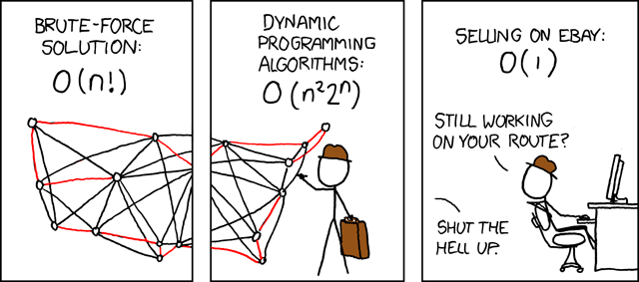
Graph Algorithms
Omkar Deshpande
http://ai.stanford.edu/~omkard/
https://xkcd.com/399/
(Some slides taken from CS161 @Stanford)
Notes:
Welcome to these videos on the foundations of graph algorithms. Graph algorithms are normally studied towards the end of a course on data structures, because they use all the simpler data structures that have been covered earlier - arrays & linked lists, stacks, queues, hash tables, priority queues, trees and so on. So please make sure that you have a basic familiarity with these other data structures, which are going to be directly used in the implementation of graph algorithms.
In case you’re wondering about the comic here, this depicts the well-known Travelling Salesman problem, which you can learn more about once you understand Graphs. The salesman depicted here needs to sell his products by traveling to a bunch of cities across the united states, and he’s trying to figure out the best order in which to visit each city so that the total distance he needs to travel is minimized. He’s trying really hard to come up with the best route but he is unable to do better than an exponential time algorithm. In fact, no one has come up with a better-than-exponential algorithm for this problem. The other salesman here has decided to be lazy and is selling all his products on Ebay in a constant amount of time, and he seems to be doing quite well.

Slide 2
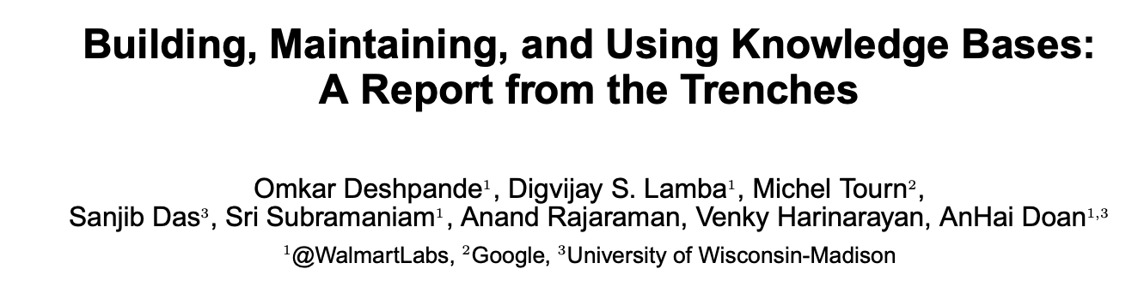
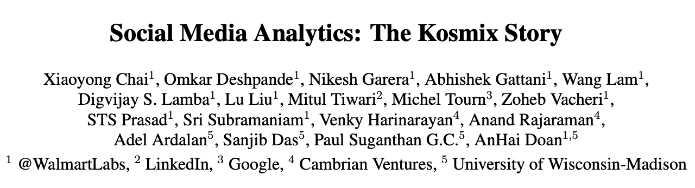
Background
Ph.D in Computer Science from Stanford University (B.Tech in CS, IIT Delhi)
Co-taught CS374 (Algorithms in Biology) and CS262 (Computational Genomics)
(ACM SIGMOD)
(IEEE Data Eng Bulletin)

Slide 3
Popular graph search algorithms for interviews
Breadth-first search (BFS)
Depth-first search (DFS)
Prim’s algorithm for Minimum Spanning Trees
Dijkstra’s algorithm for shortest paths
Best-first search and A*

Slide 4
Plan
Eulerian cycle or path problem
Graph representations
General graph traversal
BFS
Dijkstra
Prim
DFS
Best-first
A*
Bridges & articulation points
bipartite
connected components & cycles
Bellman-Ford
top.sort
SCC
Notes:
The overall structure of these videos on the foundations of graph algorithms is the following -
I am going to begin with a gentle introduction to graphs: explaining the terminology and basic concepts needed to reason about graphs. I will do this by taking a single problem, called the Eulerian cycle problem, which led to the invention of graphs in the first place. In my opinion, the best way to understand any idea is to see how it was invented, by peering into the mind of the original inventor, to draw both inspiration and a deeper understanding.
Once we solve this problem, we will attempt to take the solution and make it into an algorithm that can be run on a computer on ANY graph. For this, we need to understand how graphs, in general, can be represented on a computer.
Almost all the problems on graphs given to us will require the computer to first explore the graph systematically, starting from one point, to discover its structure, and to use that information to solve the problem. So we will look at a general graph exploration or search algorithm, and we will find something that even most computer science students miss when they study graphs; that ALL the graph algorithms they are studying: from Breadth-first search to Depth-first search to Prim’s algorithm and Dijkstra’s Algorithm, and even A* for that matter, are just variants of this general graph search algorithm. So by understanding this general algorithm well, we don’t have to struggle to memorize five or six different disconnected algorithms. We just have to understand one general algorithm clearly, and see how most of the other algorithms are variants of this general algorithm. This will form our basic graph algorithms toolkit.
We will then understand some popular extensions of these algorithms to make our graph algorithms toolkit more sophisticated. With this expanded tookit in our pocket, we will be ready to tackle most graph problems in technical interviews.
Rather than solving a bunch of disconnected graph problems, it is better to master graph algorithms in this structured manner, where you would be able to discern clearly what the various patterns underlying the algorithms are.

Slide 5
Tackling interview questions on graphs
Step 1: Could the problem be modeled as a graph problem?
Step 2: Would a simple graph traversal help solve the problem?
Step 3: Would some popular standard extension of it help solve the problem?
Step 4: Code it up
Notes:
In an interview setting, when you are given a problem, you will have to first think whether the problem can be modeled as a graph problem or not. In some cases, the problem may be an explicit graph problem, in which case there is no modeling needed. But in other cases, you may have to model the problem as a graph problem, in a way that allows you to whip out your toolkit to solve the problem. In some cases, our simple toolkit may be sufficient, but in other cases, we may have to draw upon our extended toolkit. And once you can see what algorithm in our standard or extended toolkit would solve the problem, you would then code it up.

Slide 6

https://xkcd.com/163/
Notes:
I am mostly going to be using pseudocode, so at least in these foundational videos, we won’t quibble too much over whether our array indices begin from 0 or 1, whether we have our semi-colons correct, or what corner cases and error conditions we might not have handled perfectly. All these are important for coding up the algorithms, but I want to avoid mixing them in here, because our focus first needs to be on understanding the concepts and algorithms. Once we are comfortable with them, then we can worry about those little details.

Slide 7
How it began: A person, a place, a problem and a paper
Notes:
How did graph theory begin? It began with one individual, who lived at a particular place, and worked on a specific problem, and who published the solution to it in a particular paper.

Slide 8
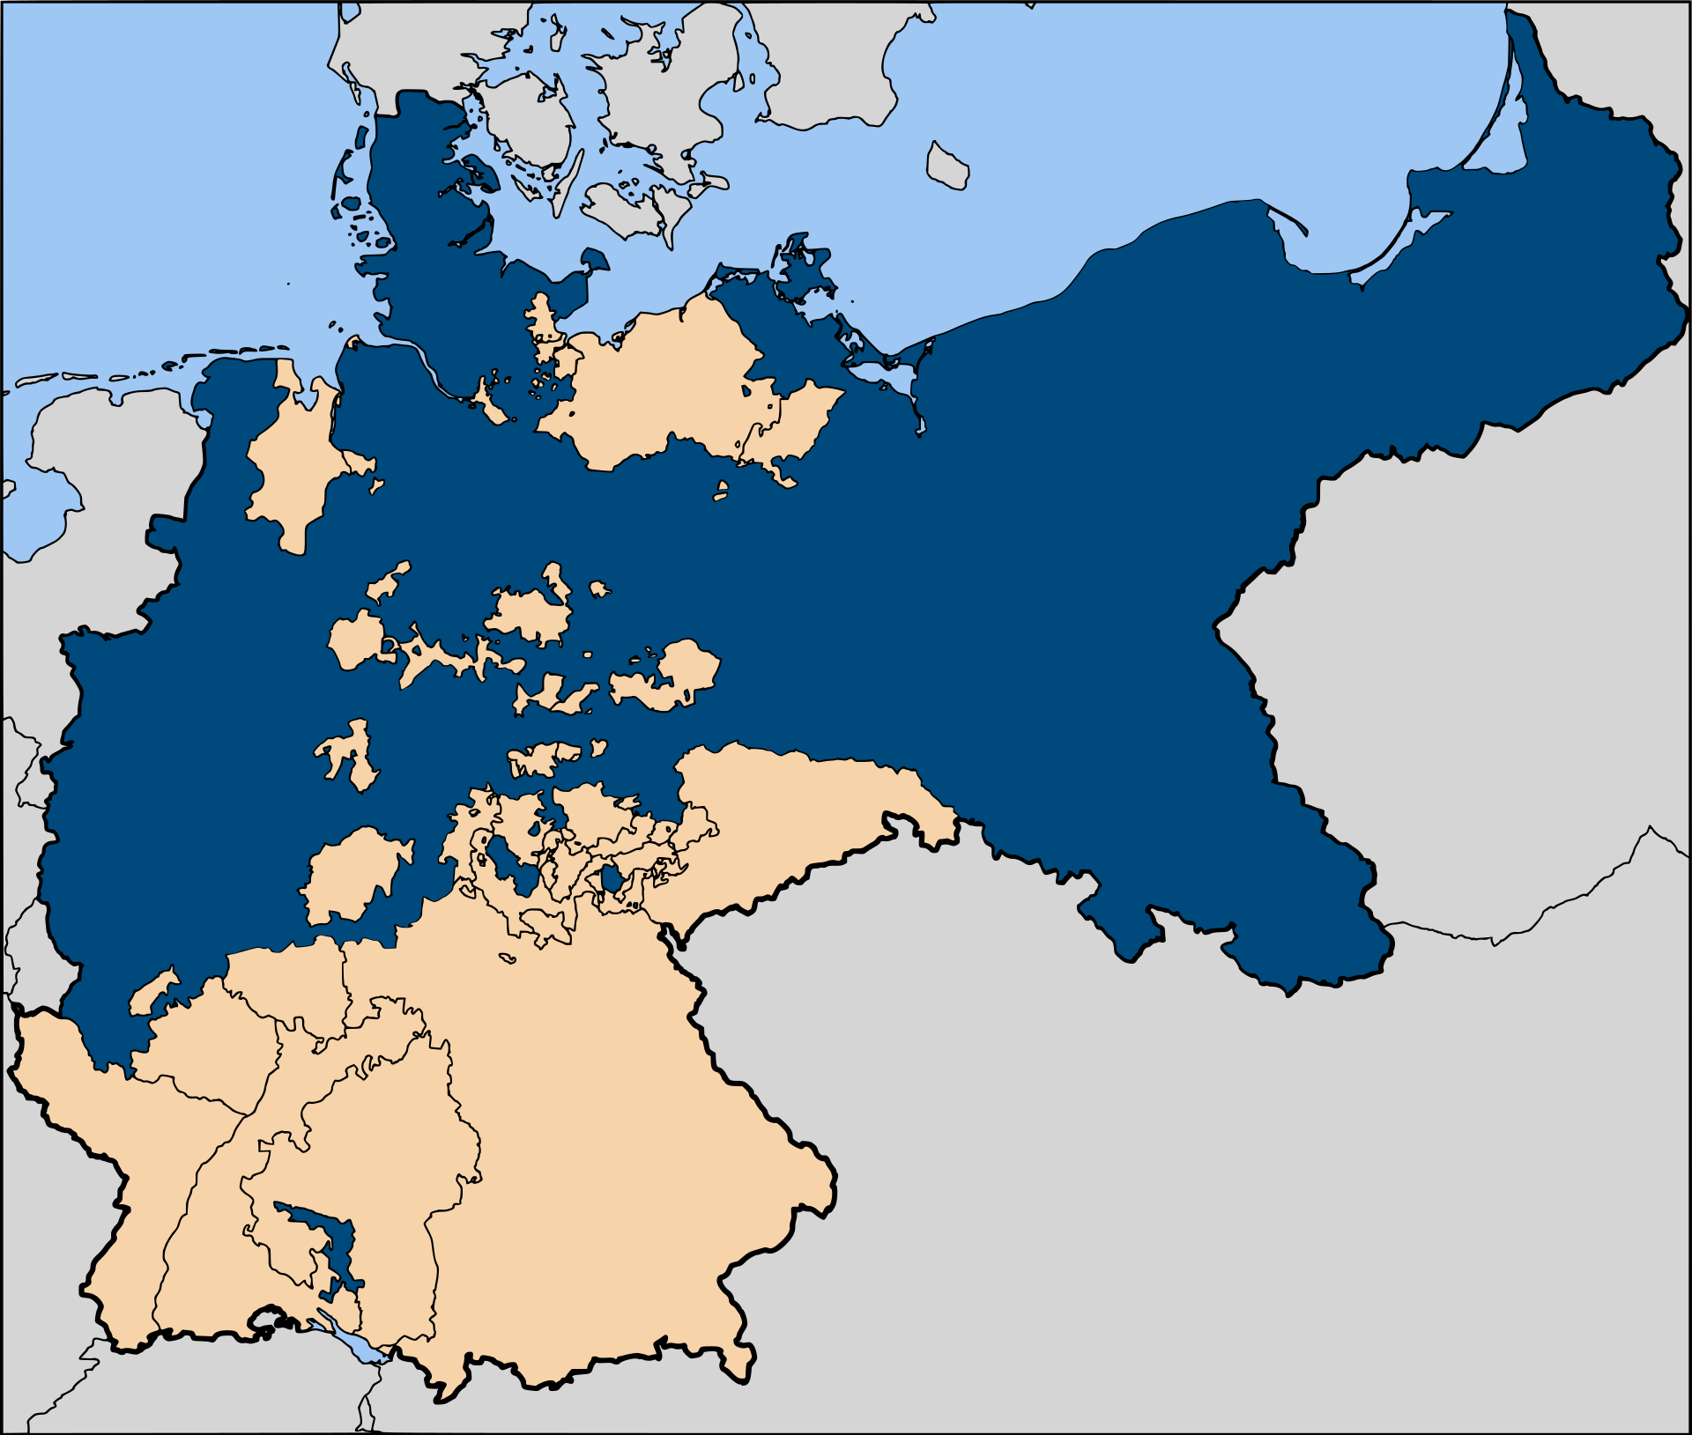
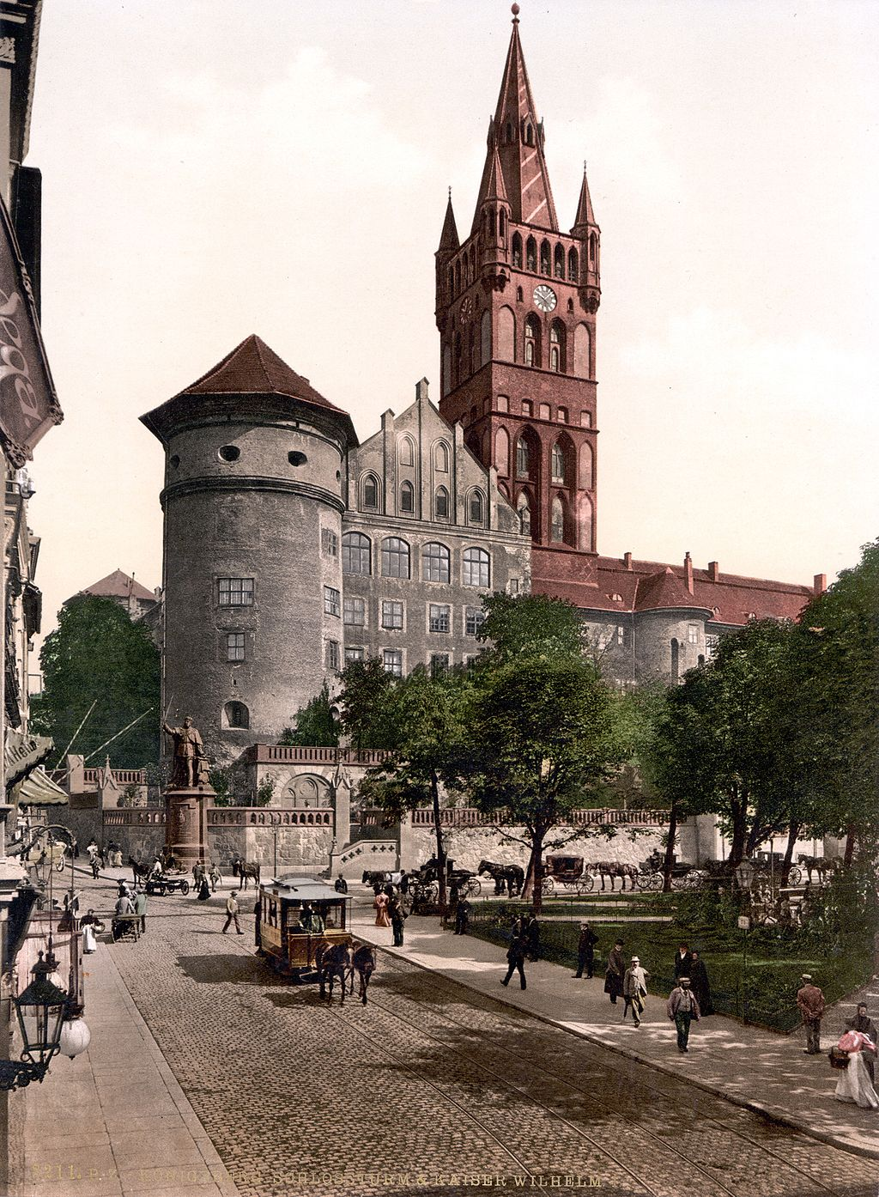
1736
Konigsberg
Prussian empire
Notes:
The year was 1736, and we’re looking at the Prussian empire in dark blue. The Prussian empire was the precursor to the modern state of Germany. The capital of the Eastern part of the empire was a city called Konigsberg, which is almost on the coast of the Baltic Sea. Here’s a picture of Konigsberg before World War I.

Slide 9

Pregel river
Notes:
Konigsberg became an important trading center because there was a river called the Pregel river which flowed through the heart of the city until it hit the coast. This allowed ships to sail right into the middle of the city, laden with all kinds of goods. With all the money coming in from trade, the residents of the city decided to use some of it to build seven bridges across the Pregel river.

Slide 10
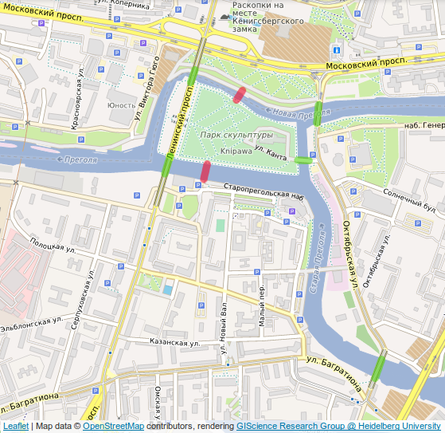
Notes:
They are all shown here on this Google maps image. On Sunday mornings, the residents of the city would go for their morning walks, crossing one or more of these bridges. Some of them began to wonder about the following question.

Slide 11
Can one walk across the seven bridges without crossing the same bridge twice?
Notes:
Can one walk across the seven bridges, crossing each of them exactly once, and come back home? No bridge should be repeated, and no bridge should be left out.

Slide 12
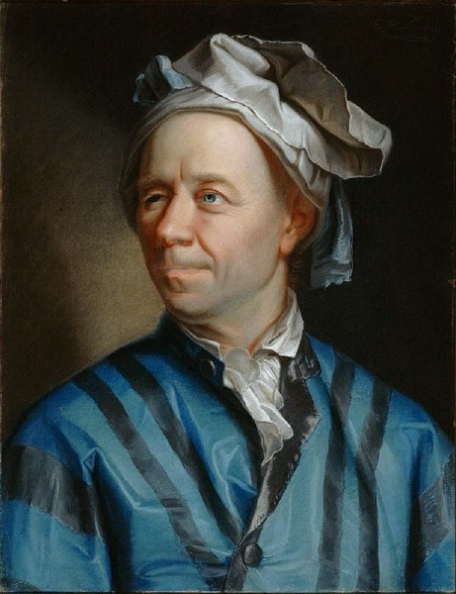
“You would render to me and our friend Kuhn a most valuable service, putting us greatly in your debt, most learned sir, if you would send us the solution, which you know well, to the problem of the seven Konigsberg bridges together with a proof. It would prove to an outstanding example of the calculus of position worthy of your great genius. I have added a sketch of the said bridges”.
(Letter from the Mayor to Euler)
Notes:
The curiosity of the residents was strong enough that they took it up with the Mayor. He was not an expert mathematician himself, but he wrote to the greatest mathematician of that time, and one of the greatest in all of human history: Leonhard Euler. He requested Euler to send him the solution to the problem with the proof. He had sent him a sketch of the locations of the bridges, which may have looked something like this.

Slide 13
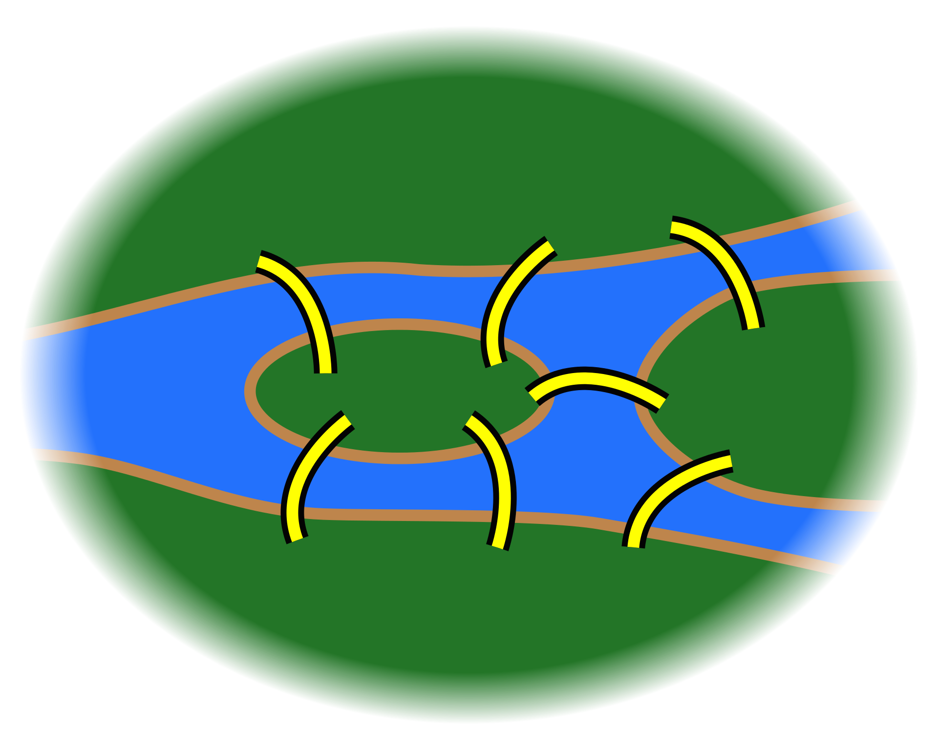

Slide 14
“This question is so banal, but seemed to me worthy of attention, in that neither geometry, nor algebra, nor the art of counting was sufficient to solve it. In view of this, it occurred to me to wonder whether it belonged to the geometry of position...”.
(Euler’s letter to an Italian mathematician)
Notes:
Euler looked at the toolkit he had available at that time, drawn from the different domains of mathematics. The problem couldn’t be solved using geometry, or algebra, or combinatorics and number theory. So as far as he was concerned, it wasn’t even a mathematical problem. In fact, he wrote in a letter that he doesn’t understand why he of all people ended up solving the problem, because it wasn’t really a mathematical problem, so anyone could have solved it!

Slide 15
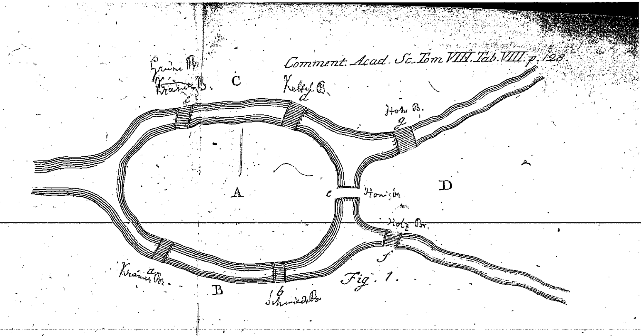
Notes:
Euler published the solution to the problem in a paper. This is his sketch of the bridges of Konigsberg in the paper.

Slide 16
Each land area denoted by a letter.
Notes:
Notice that he represented each land area by a single letter A, B, C and D. That was his way of saying that it didn’t matter what the shape of the land region is, or what its size is. All that mattered is that there were these four land regions A, B , C and D, and between A and B, there were two bridges. Between A and C, there were two bridges. And so on.

Slide 17
“For this I use the capital letters A, B, C, D, for each of the land areas separated by the river. If a traveller goes from A to B over bridge a or b, I write this as AB — where the first letter refers to the area the traveller is leaving, and the second refers to the area he arrives at after crossing the bridge.”
(Euler’s 1736 paper)
Tip: Check if the given problem can be modeled as a graph.
Notes:
If someone walked across a bridge from A to B, that would be represented as AB. Since there were two bridges between A and B, he distinguished them by using small letters a and b.

Slide 18
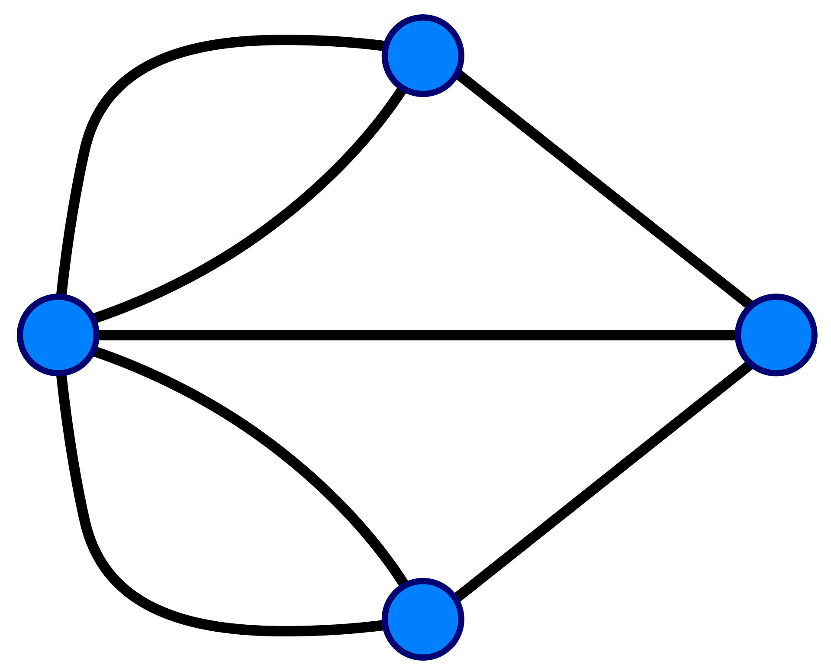
Graph
(undirected)
C
Vertex / Node C
Edge (C,D)
A
D
Adjacent
Path
Cycle
B
Notes:
Today, we would represent this using a diagram like this. There are four vertices (or nodes) corresponding to the four land regions A, B, C and D. The vertices are connected by lines called edges. The two edges connecting A and B represent the two bridges connecting them in the map. Since one can walk across a bridge in either direction, the edges don’t have any directions on them. So the edge from C to D is the same as the edge from D to C. This diagram of vertices and edges is called a Graph, and this is an undirected graph because the edges don’t have directions on them. If they were one-way streets, we would have put arrows on them indicating the allowed direction of movement across them. Then we would have called this a directed graph.
Two vertices are said to be adjacent if there is an edge directly linking them. Vertices C and D are adjacent. B and C are not adjacent.
A path in a graph is a sequence of adjacent vertices. CDB is a path. DBC is not a path because there is no edge between B and C.
A cycle in a graph is a path that ends at the same vertex from where it started. CDBAC is a cycle. ADBA is also a cycle. CDBC is not a cycle, because it’s not a valid path.
Euler himself did not use such a diagram, nor did he use terminology like Graph, Vertex, or Edge. The terminology was developed much later. In fact, the first textbook on graph theory was written in 1936, 200 years after the story we are looking at. It was written by Konig, whose name has a coincidental resemblance with the name of the city of Konigsberg.

Slide 19
“After some deliberation, I obtained a simple rule with whose help one can immediately decide for all examples of this kind, with any number of bridges in any arrangement, whether such a round-trip is possible”.
(Letter from Euler to an Italian mathematician)
Tip: Make sure your solution works for a general instance, not just the example given.
Notes:
Euler set out to develop a solution not only for the specific example of the map of Konigsberg, but for a general graph, with any number of edges and vertices in any arrangement. In a similar way, the solution we develop for a graph problem in an interview setting has to work on a general graph, not just on an individual example that might be given to us.

Slide 20
“As far as the problem of the seven bridges of Konigsberg is concerned, it can be solved by making an exhaustive list of all possible routes, and then finding whether or not any route satisfies the conditions of the problem. Because of the number of possibilities, this method of solution would be too difficult and laborious, and in other problems with more bridges it would be impossible”.
Tip: You may start with a brute force solution but need to go beyond it.
Notes:
The first attempt to solve any problem would be a brute force approach. Euler says that we can exhaustively list all possible paths of a certain length and see how many of them satisfy the condition of the problem. But because there would be too many paths to enumerate, Euler dismisses it as an impractical approach.
Nevertheless, it is good to start with a brute force approach, just to confirm that you have understood the problem correctly. If there is any misunderstanding about the statement of the problem, then it’s better for it to be discovered early in the interview. You don’t want to spend a lot of time coming up with an algorithm only to find that you misunderstood the problem.

Slide 21
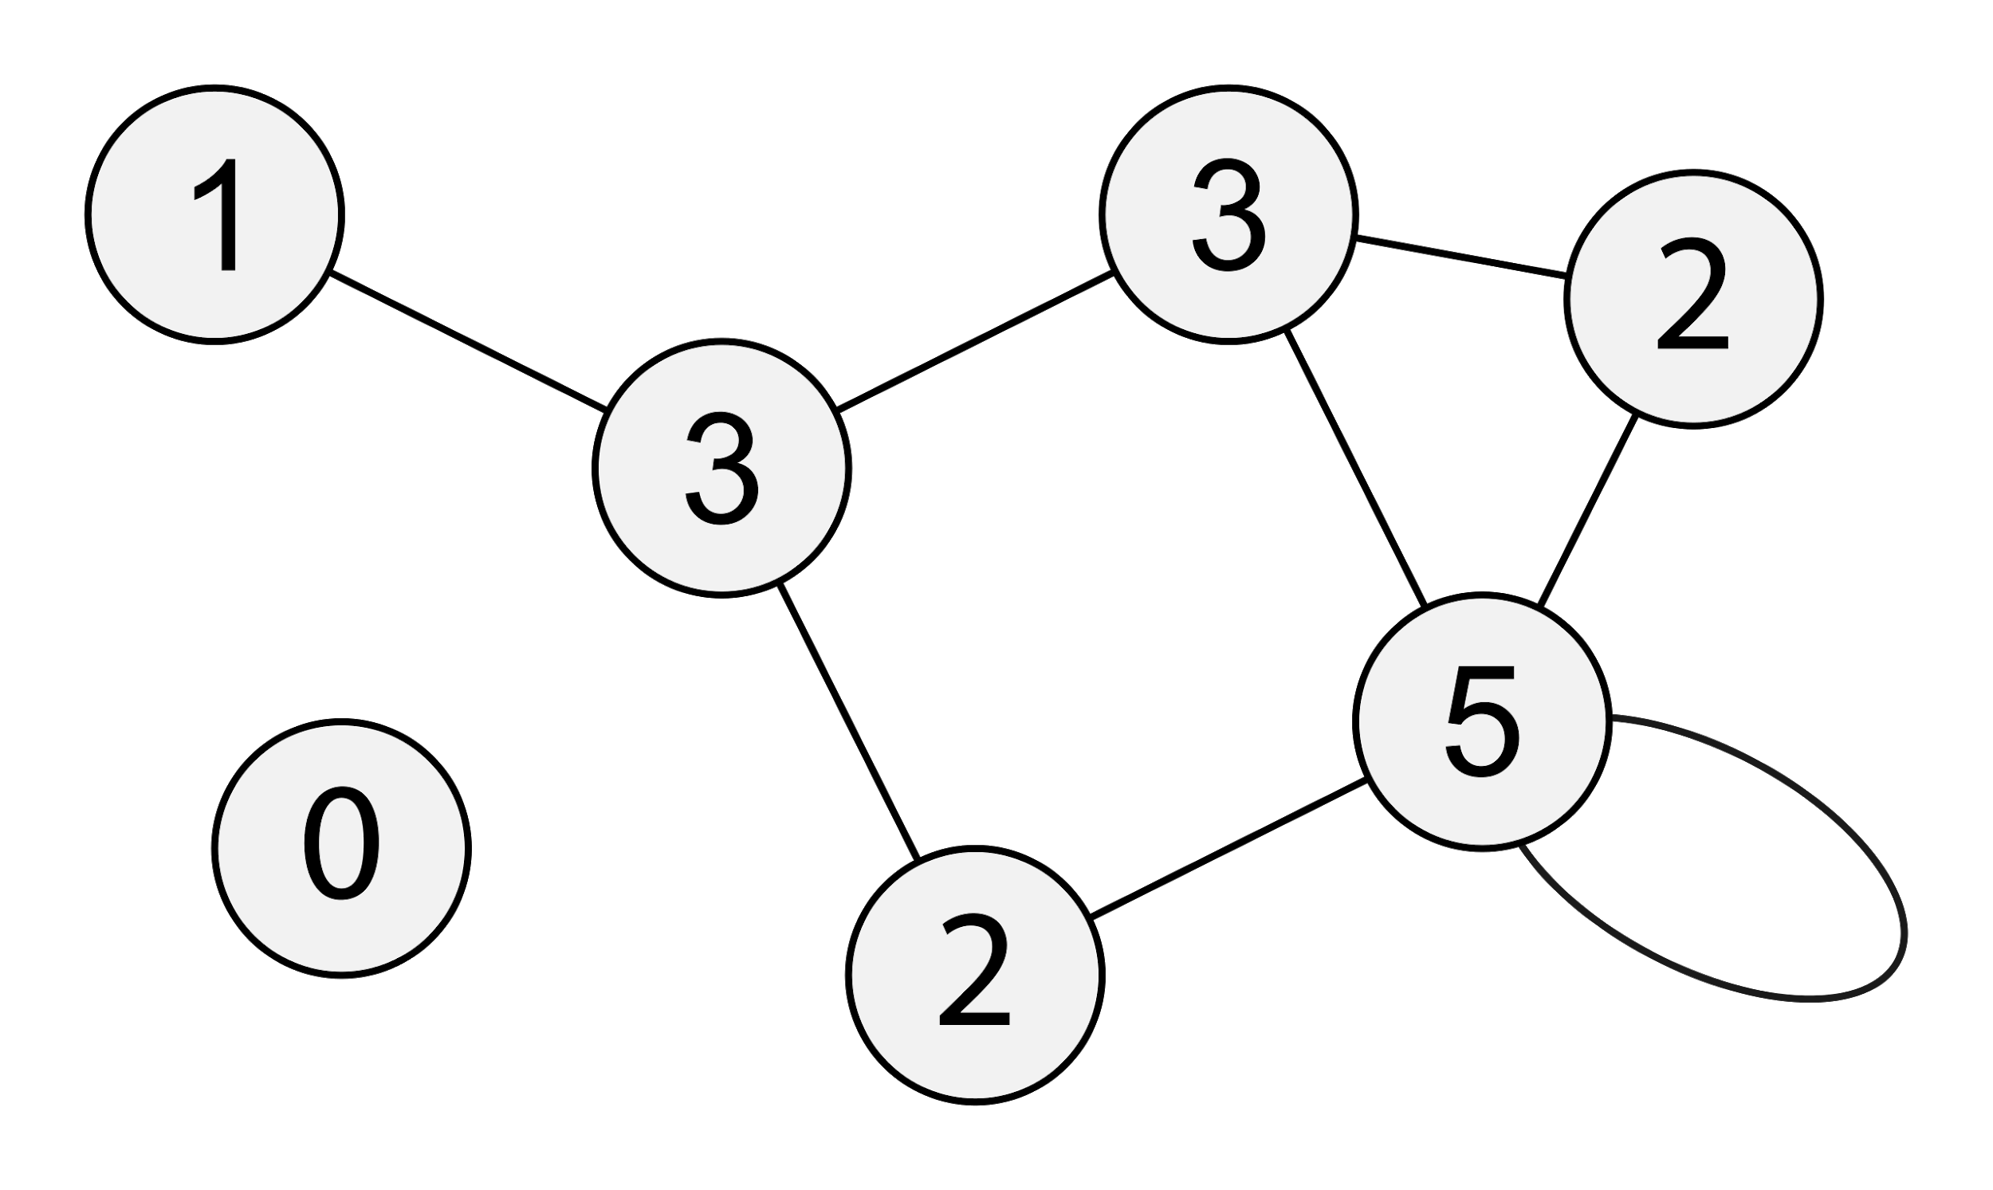
Degree
Notes:
Some additional terminology: the degree of a vertex is the number of vertices adjacent to it. And that is nothing but the number of edges sticking out from the vertex. The degree of every vertex in this graph is shown as a number written on that vertex. Notice the self-loop we have in this graph. In general, the graphs we will look at won’t have self-loops, and they also won’t have multiple edges connecting the same pair of vertices, like we had in the map of Konigsberg. If we have multiple edges between the same two vertices, or if we have self-loops, then we call this kind of representation a multi-graph.
It turns out that the solution to this problem would be the same even if we had a multi-graph, so it doesn’t matter here.

Slide 22
The sum of the degrees of all the vertices in an undirected graph G = (V, E) is
|E|
|V|
2|E|
2|V|
What about directed graphs?
Notes:
What do we get if we summed up the degrees of all the vertices in an undirected graph? By the way, we generally write a graph G as a combination or ordered pair of a set of vertices V and a set of edges E. Pause the video, and think about this question before proceeding further.
When we add the degrees of all the vertices, we are effectively counting each edge twice, one from each of its endpoint vertices. So the sum turns out to be 2|E|.
A directed graph has a notion of In-degree and Out-degree.
The sum of the out-degrees of all vertices = The sum of the in-degrees of all vertices = |E|

Slide 23
“I observe that the numbers of bridges written next to the letters A, B, C, etc. together add up to twice the total number of bridges. The reason for this is that, in the calculation where every bridge leading to a given area is counted, each bridge is counted twice, once for each of the two areas which it joins.”
Notes:
Euler says the same thing in these words.

Slide 24
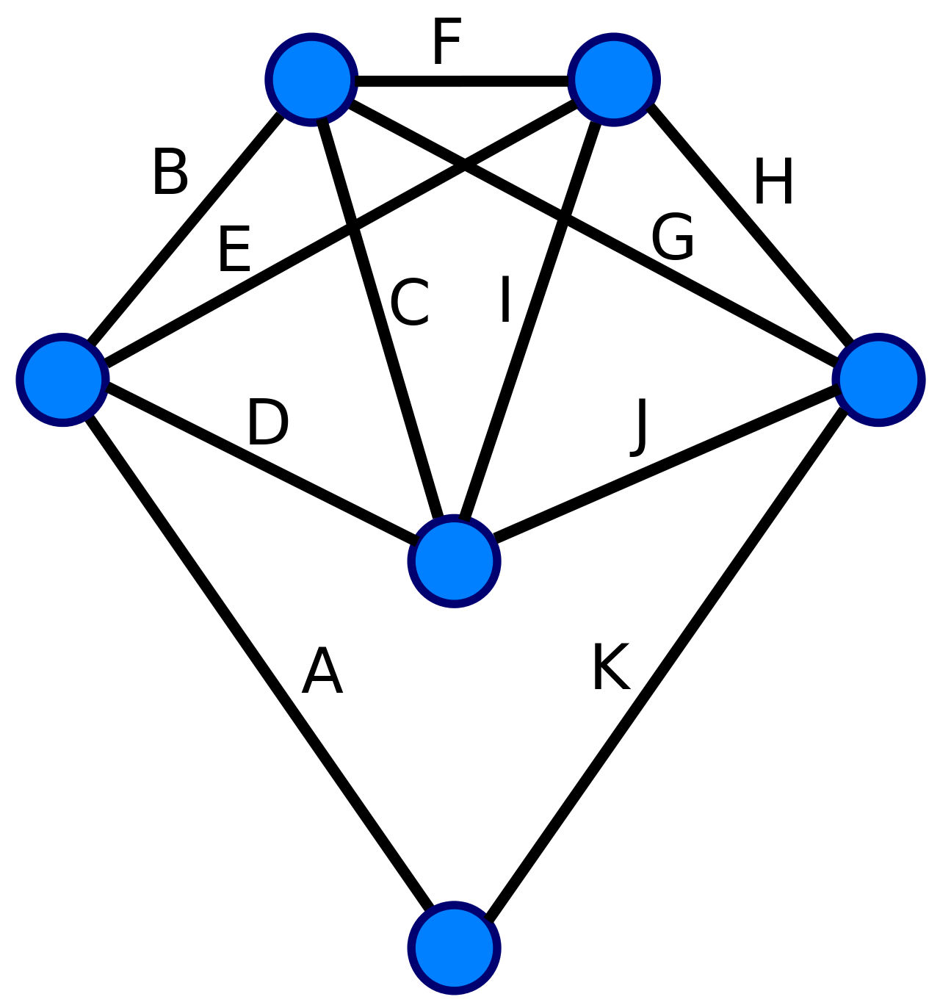
A
D
E
B
C
Eulerian path
Eulerian cycle
Notes:
https://www.nctm.org/Classroom-Resources/Illuminations/Interactives/Graph-Creator/
This problem of determining whether a given undirected graph has a cycle covering each edge exactly once, is called the Eulerian cycle problem, in honor of Euler.
Here, we have a different graph from the Konigsberg graph, and you can see that this graph does have an Eulerian cycle in it, marked by edges in alphabetical order.
It is also possible that we can have a non-cyclical path that traverses all edges exactly once. It may end up somewhere else, instead of ending at the start vertex. Such a path is called an Eulerian path.
Every Eulerian cycle is an Eulerian path, because every cycle is a path.
Given a graph, one can ask if there is an Eulerian cycle in the graph? One can also ask if there is an Eulerian path in the graph. These are two slightly different problems. We shall focus on the Eulerian cycle problem first, and once we solve that, then we can think about the Eulerian path problem.

Slide 25
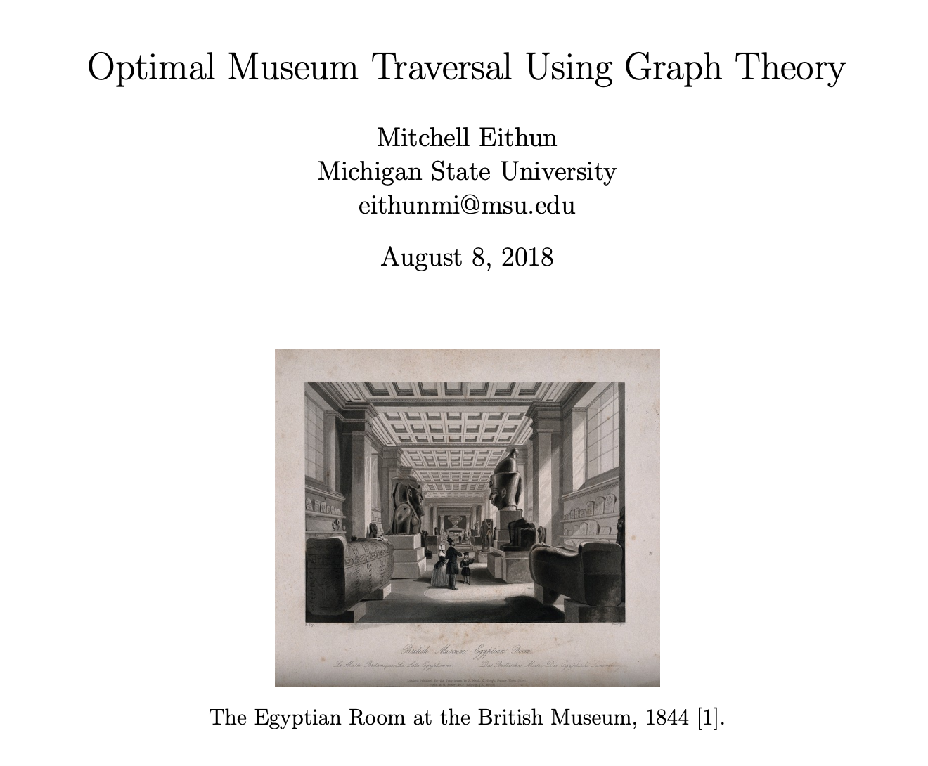
Notes:
I said at the beginning that modeling a given problem as a graph problem will often be the first step. We saw how to model the seven bridges of Konigsberg problem as a graph problem: the Eulerian cycle problem. Let me show you a few examples of other problems that can also be modeled as the Eulerian cycle problem.
Suppose you go to an art museum, where the various works of art are displayed on various walls of the museum. Your time is limited, so you want to start from the entrance of the museum, and tour the museum in a way that you see every painting on every wall of the museum, without missing any wall, and without repeating the same wall. At the end, you want to be back at the entrance. Is it possible to tour a given museum in this manner?
This problem can be modeled as the Eulerian Cycle problem.
The walls can be modeled as edges, and corners between walls modeled as vertices. Saying that I want to tour the museum in a way that I visit every wall exactly once, is the same as saying I want to tour this graph so that I visit every edge exactly once.
What if you model walls as vertices, and corners between walls as edges? The resulting graph would need to have a tour visiting all VERTICES. That would be a different problem, called the Hamiltonian cycle problem, which is an NP-Hard problem. That’s another way of saying that there is no known polynomial time algorithm for that problem. So it matters how you model your problem as a graph problem. The modeling has to be done in a way that allows you to solve the problem efficiently. We shall see soon that the Eulerian cycle problem can be solved efficiently.

Slide 26


“An algorithm to trace the itinerary of a snow ploughing truck that respects street priorities is developed. It is based on the notion of an Eulerian circuit... “
Notes:
Suppose there has been a snowstorm in an area, and the roads are all covered with snow. A snow ploughing truck needs to remove snow from all the roads. It needs to follow a path that is efficient, which means it should always be going along a road that is covered with snow, not wasting time going along a road that has already been cleared up. And at the end, every road should have been cleared of snow. Is it possible for the truck to follow a path that satisfies these conditions and comes back to the station?
If we model this problem as a graph, where the intersections between roads are vertices, and the roads are the edges, then the problem reduces to asking if the graph has an Eulerian cycle in it.

Slide 27
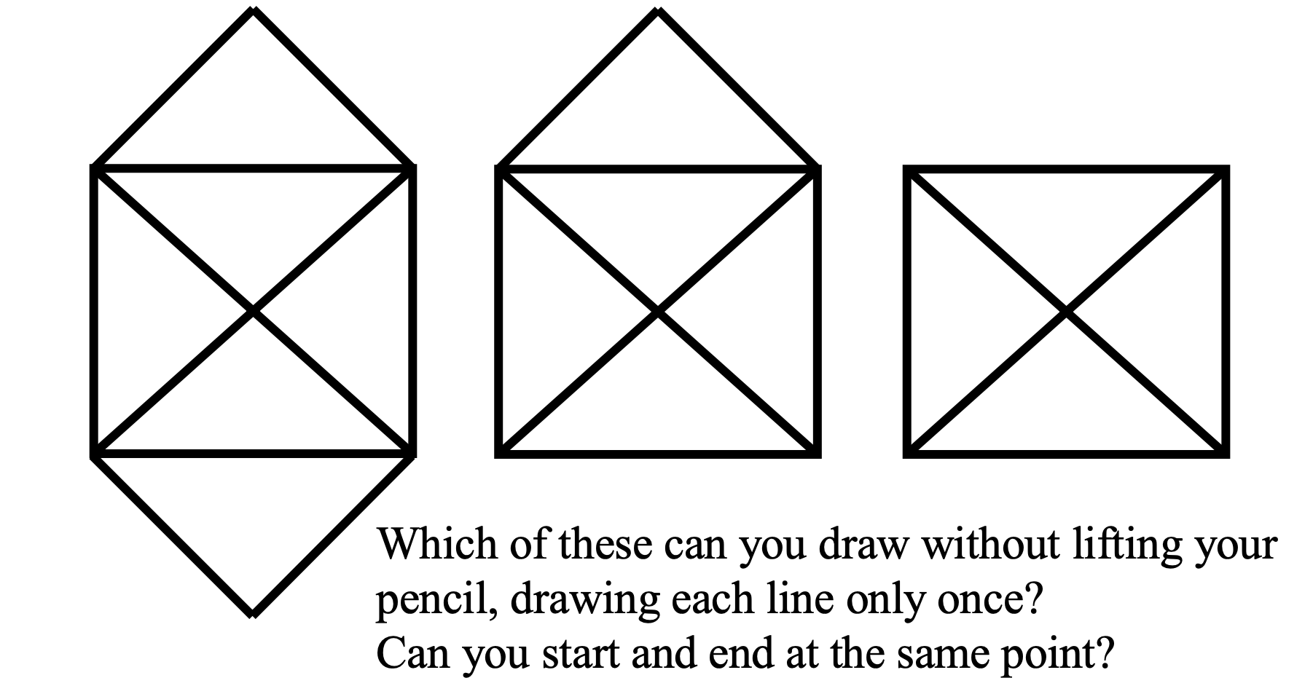
Notes:
Or suppose you are given one of these diagrams, and you are asked if it is possible to draw the diagram without lifting your pencil even once, and without retracing any line that has already been drawn. And, you need to end at the same point from where you started. If every corner is represented as a vertex, and every straight line segment is represented by an edge, we are again being asked to determine if there is an Eulerian cycle in the resulting graph.

Slide 28
Different word problems can map to the same graph problem.
Notes:
From these different examples, we can draw the lesson that different word problems can be modeled by the same graph problem. So if we can master the right set of graph problems, then most of the problems we will encounter can be solved by modeling them with the right graph problem.

Slide 29
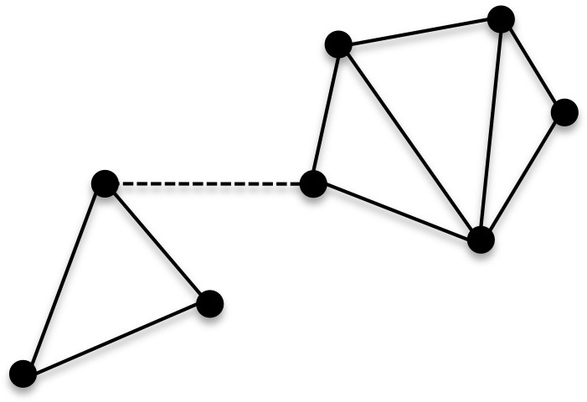
Connected graph
Notes:
Before we look at how to solve the Eulerian cycle problem, there is one additional term we need to be familiar with. An undirected graph is said to be connected if you can start from any vertex and reach any other vertex. This graph is connected. But if we were to delete the dotted edge, then it would become disconnected. It would split into two “connected components”. A connected component is a piece of the original graph within which you can start from any vertex and reach any other vertex. And you can’t grow the connected component further by adding more vertices. It cannot be enlarged without losing the connectedness property.

Slide 30
If a graph has an Eulerian cycle, it must be connected?
Notes:
One may think that for a graph to have an Eulerian cycle, it must be connected. If it is not connected, it cannot have an Eulerian cycle.
Sounds reasonable?

Slide 31
Notes:
But look at this graph. It is not connected, it has two connected components. But it does have an Eulerian cycle, a cycle that visits every edge of the graph exactly once.
So it is possible for a graph to have an Eulerian cycle even if it is disconnected. What we can say is that all the edges of the graph must belong to the same connected component. If they are not part of the same connected component, it would be impossible to visit them all.
For our purposes, we will assume for now that our graph is connected. So all the edges are definitely part of the same connected component. Later on, we may come back and ask how do we check that all the edges are part of the same connected component. For now, we will assume that they are.

Slide 32
Notes:
So here is the connected graph which we saw earlier, with the Eulerian cycle marked.

Slide 33
Observation: Every time we enter a vertex, we exit it along some unused edge.
Notes:
One observation we can make is that …
This is clearly true for all the intermediate vertices. As for the start vertex, we exit it at the beginning and come back to it at the end.

Slide 34
Observation: Every time we enter a vertex, we can exit it along some unused edge.
So the degree of every vertex must be even.
Notes:
So we can say that if the graph has an Eulerian cycle, then the degree of every vertex in the graph must be even.

Slide 35
If the degree of any vertex is odd, the graph cannot have an Eulerian cycle.

Slide 36
Notes:
Each of the 4 vertices in the Konigsberg graph (or rather multigraph) had an odd degree. So it can’t have an Eulerian cycle.

Slide 37
Notes:
Diagrams 2 and 3 have at least some vertices with an odd degree. So they cannot have an Eulerian cycle. But look at Diagram 1. The degree of every vertex in it is even. Does that mean there is an Eulerian cycle in it?

Slide 38
If a graph is connected, and the degree of every vertex is even, does it have an Eulerian cycle?
Notes:
We know that if a graph has an Eulerian cycle, the degree of every vertex must be even. But is the converse true?
Draw a fish diagram to trace Eulerian cycle in that graph.

Slide 39
If a graph is connected, and the degree of every vertex is even, does it have an Eulerian cycle? Yes!

Slide 40
A connected graph has an Eulerian cycle if and only if the degree of every vertex is even.
Notes:
This also applies to graphs that may not be connected but at least all the edges are part of the same connected component.

Slide 41
Notes:
Let’s draw an Eulerian cycle in Diagram 1.

Slide 42
What about Eulerian paths?

Slide 43
If there exists an Eulerian path in a connected graph, either that path is a cycle, or it starts and ends at two different vertices.
Notes:
We can do a similar analysis with Eulerian paths. Assume that the graph is connected for now. If there exists an Eulerian path in a graph, either that path could be an Eulerian cycle. Or it could start and end at two different vertices.

Slide 44
If there exists an Eulerian path in a connected graph, either that path is a cycle, or it starts and ends at two different vertices. These are the only two vertices that would have an odd degree.
Notes:
….Why?
Intermediate vertices need to have an even degree, because every time you enter them along an unused edge, there must be another unused edge to exit from. So the edges for those vertices have to be paired up in this way, which means the degree of intermediate vertices has to be even.
The start vertex is allowed to have an odd degree because you would ultimately leave it and never come back to it. So the edge you used to leave it doesn’t have to be paired up with another edge coming back to it.
In the same way, the end vertex is allowed to have an odd degree because you come to it at the end, and you didn’t start from there, so the last edge that you used to enter it won’t be paired up with another edge.
As an aside, we should note that it is NOT possible for a graph to have just a single vertex with an odd degree (and everyone else having an even degree). Why? Because the sum of the degrees of all the vertices has to be even. We saw that earlier. If there is only a single vertex with an odd degree, then the summation of all the degrees of all the vertices would be odd, which is impossible. By the same exact reasoning, it is not possible for a graph to have exactly 3 vertices with an odd degree, or 5 vertices with an odd degree, or any odd number of vertices with an odd degree. Why? Because when we add up the degrees of all the vertices, we would be adding an odd number of odd numbers, and the result would be an odd number. Which is impossible.
So the number of vertices in a graph with an odd degree can only be 0, or 2, or 4, or 6, and so on. It has to be an even number of vertices with an odd degree.
If that number is 0, i.e, if every vertex has an even degree, then we know the graph has an Eulerian cycle. What if it’s 4, or 6, or more? Then we cannot have An Eulerian cycle in the graph, and in fact we cannot even have an Eulerian path in the graph. We just saw that if there is an Eulerian path, then either it is a cycle, or if it’s not a cycle, only two of vertices will have an odd degree.

Slide 45
If a connected graph has exactly two vertices with an odd degree, does there necessarily exist an Eulerian path in it?
Notes:
So let’s think about the converse … Let’s try to use what we did before. We did a lot of work to show that if every vertex has an even degree, then there must exist an Eulerian cycle in the graph. Here, we have two vertices with an odd degree. What if we add an edge linking them together? Then the resulting graph would have every vertex with an even degree. This graph would have an Eulerian cycle. Let’s say we draw the cycle, and then we delete the edge we had added. This would break the cycle, and we would get a path between the two vertices with an odd degree, a path that visits every edge of the graph exactly once. This is the Eulerian path we were looking for!
So yes, ….

Slide 46
If a connected graph has exactly two vertices with an odd degree, does there necessarily exist an Eulerian path in it? Yes! Suppose you added a new edge to link those two vertices together. The resulting graph would have an Eulerian cycle. If we then remove the edge we had added, we would get an Eulerian path.

Slide 47
Notes:
Diagram 2 in this set has exactly two vertices with an odd degree. So even though it doesn’t have an Eulerian cycle, it does have an Eulerian path.

Slide 48
“If there are more than two areas to which an odd number of bridges lead, then such a journey is impossible.
If, however, the number of bridges is odd for exactly two areas, then the journey is possible if it starts from either of these areas.
If, finally, there are no areas to which an odd number of bridges lead, then the required journey can be accomplished from any starting point.
With these rules, the given problem can also be solved. ”
Notes:
So here is Euler’s way of succinctly summarizing his solution. If we are given a connected graph, we just look at how many vertices in it have an odd degree. If that number is more than 2 (it is 4 or 6 or more), then there cannot exist an Eulerian cycle or an Eulerian path in it.
…..

Slide 49
Graph representation

Slide 50
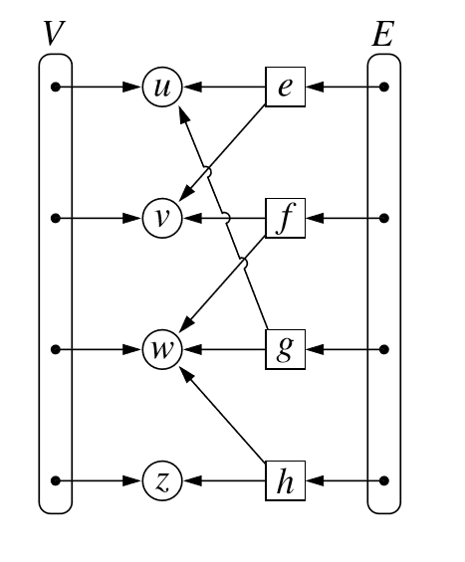
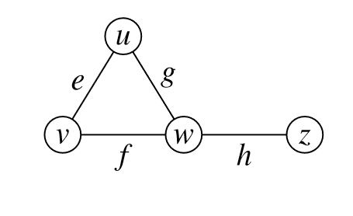
Edge lists
Since G = (V, E), why not maintain V and E as lists?
Notes:
Since a graph G is a set of vertices and edges, why not maintain them both as lists?
Vertexlist = [u,v,w,z]
Edgelist = [e, f, g, h]
Even though both are lists, we use the term edge lists because the complexity of our algorithms will generally be determined by how the edges are stored. The number of edges in an undirected graph with n vertices can be as high as n-choose-2 or n(n-1)/2 which is O(n^2). So generally, whenever our algorithms look at and explore a graph, their time complexity is going to be governed by how the edges are stored and processed. And there is not going to be much of a difference in how the vertex information is stored. But how the edges are stored would vary drastically from one representation to another.
Let’s take an example to see how we could store vertices. If I am maintaining a graph of cities and roads connecting the cities, I would have a vertex object for every city. So San Francisco could be one of the city objects, and its area, population, amount of rainfall, etc would be maintained as attributes of the city object. To find a vertex quickly, we could maintain the vertices in a hash table, indexed by the name of the city. Or maybe each vertex is assigned a unique integer key, from 0 to V-1, in which case we can store vertex references in an array or a Python list. Then vertexarray[1] or vertexlist[1] would give us a reference to the city with id = 1. So these are a couple of ways in which the vertex collection could be maintained.
As for the edges, in an edge list like shown here, the edges are all stored in an unordered list. Each edge has two pointers to its endpoint vertices (these could be pointing at those vertex objects directly, or they could mention the vertex id, using which can then access the vertex information.. And if there is any extra information associated with an edge, like a weight or a cost or a distance as in the case of our example where edges represent roads, that distance value would be maintained inside the edge object.
Now, when we are trying to explore a graph to discover its structure, as all our algorithms will do, we will need to start from some vertex, look at its neighbors, and then go to some of them and look at their neighbors and so on. Looking up the neighbors of any given vertex in this kind of representation will take a lot of time, because we have to traverse the whole edge list, and see which of the edges pertains to that vertex, and filter those out, and look at the other endpoint of those edges. This will take O(E) time or O(m) time, since we often use m to denote the number of edges in a graph, and n to denote the number of vertices. So if we have to look up the neighbors of every vertex, that is going to take O(mn) time. Since m itself can be as large as order of n^2, we are talking about an O(n^3) algorithm to look at all the vertices and their neighbors. We can certainly do better than that.
The space complexity of this representation is O(m + n) since each edge and each vertex takes up a constant amount of space.

Slide 51
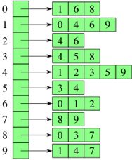
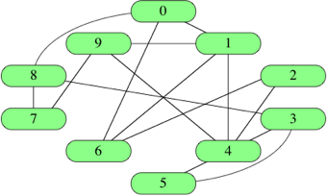
Adjacency list
Applies to both undirected and directed graphs.
Notes:
Since it seems too expensive to store the edges in a single, global, unsorted list, why not store each edge with its endpoint vertices? That way, when we want to look at all the neighbors of a vertex, we can directly go to the list of edges that are incident on THAT vertex. For example, in this graph, vertex id 0 has three edges going out to vertex ids 1, 6 and 8. We can have a small list of those three edges and store a pointer to the list from vertex id 0. This kind of a structure immediately gives us the list of neighbors of a vertex. For example, the vertex with id 6 has neighbors 0, 1, and 2 respectively.
This way of storing edge information is called an adjacency list, because it tells us which vertices are adjacent to a given vertex. Instead of a single long list of edges (as in an edge list), it stores an array of much smaller lists of edges.
In an undirected graph, the same edge between u and v would be stored twice: v would be stored in the adjacency list of u, and u would be stored in the adjacency list of v.
In a directed graph, an edge (u,v) would have a direction, so if we store every edge with the vertex that it is going out of, then v would be stored in the adjacency list of u, but not vice versa.
The space requirement for an adjacency list is also O(m + n), a constant amount of space for every vertex and every edge. By the way, I have not shown here how the vertices are maintained. There are no vertex attributes that are being stored in this adjacency list. As I told you before, vertices and all the data and attributes they have would be maintained in a similar way as an independent collection, no matter how the edges are stored. We are looking here at different ways to represent edges.
Having said that you can imagine taking the class definition of a vertex, and storing a pointer to the adjacency list for that vertex in there. This way of storing vertices and edges would certainly work. But if the same vertex is going to be part of multiple graphs, then we can’t have a single adjacency list for the vertex stored in there. We can store the adjacency lists for each of those graphs separately, the way it’s shown here, and It’s best to store the vertex information just once, outside of any of those adjacency lists. So it’s useful to think of the adjacency list as storing the edge information, and the vertex information lies somewhere else.

Slide 52
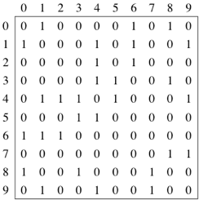
Adjacency matrix
Applies to both undirected and directed graphs.
Notes:
A third way to store edge information is by having an n X n matrix. Remember n is the number of vertices. If vertex i has an edge to vertex j, then row i, column j would be a 1. Else it would be a 0. For example….
This matrix is called an adjacency matrix as it again stores edge information; which vertices are adjacent to which vertices. Remember that the vertex attributes are being stored separately in an independent collection.
In an undirected graph, again the edge (u,v) would be represented twice in this matrix. Once in row u, column v, and once in row v, column u. The matrix in that case would be symmetric. And since a regular graph has no self-loops, these diagonal entries will all be 0.

Slide 53
Adjacency matrix
Needs O(|V|²) space.
Good for dense graphs (in which |E| ~ |V|²)
Only one bit per entry sufficient
Notes:
An adjacency matrix takes O(n^2) or O(V^2) space. It doesn’t matter how many edges are in the graph. The space requirement is fixed. So obviously it makes sense to use this kind of representation only when the graph is a dense graph…. Since all we are stored is a 0 or a 1, we can use a bit matrix to store this using minimum space.

Slide 54
Adjacency list
Needs O(|V| + |E|) space
Good for sparse graphs (in which |E| << |V|²)
Majority of algorithms use this representation
Notes:
Since an adjacency list needs O(m + n) or O(V + E) space, where the graph is sparse, i.e, the edges are not of the same order as V^2, maybe a multiple of V, then it makes sense to use an adjacency list, instead of adjacency matrix which would necessarily require O(V^2) space. Most of the algorithms we will look at will use an adjacency list representation, or a variant of it which I will talk about shortly.

Slide 55
What if we need to quickly tell if there is an edge (u,v) in the graph?
What if each edge has an associated weight? How would we incorporate that?
Notes:
Adjacency matrices are good to quickly tell if there is an edge (u,v) in the graph. Adjacency lists on the other hand, would take time O(degree(u)). Why?
Instead of storing a 0/1 in a bit matrix, we would store integer values for the edge weights in an adjacency matrix.
In an adjacency list, we would also store the weights for each edge. The adjacency list would be an array of lists of pair<int1, int2> where int1 is vertex id of neighbor, and int2 is edge weight to that neighbor.
Also note that unless your vertices have convenient IDs from 0 to V -1 (or 1 to V), you will be using a hashmap to go from vertex ID to the adjacency list in O(1) expected time.
There is a variant of an adjacency list that I want to mention here, which addresses the above problem: that it takes a little time to find out whether v is a neighbor of u in the graph.

Slide 56
Adjacency maps
Adjacency map uses a dictionary (hash table) to store the neighbors of vertex v, instead of a list of neighbors (as in adjacency list).
This allows you to not only iterate over the neighbors if you wish (like in adjacency list), but also find out in O(1) expected time if w is a neighbor of v and to get the edge weight of (v,w) if applicable.
Adjacency matrices provide that lookup in O(1) time, so in some sense, Adjacency map combines the advantages of Adjacency lists (in space) and Adjacency matrices (in time).
Notes:
It’s called an adjacency map...

Slide 57
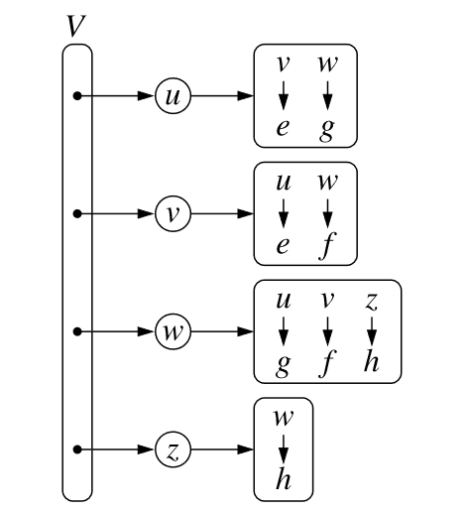
Adjacency map

Slide 58
Adjacency list
class Graph {
}
Notes:
Since adjacency lists are easy to visualise, we will use them, though you can use adjacency maps instead of adjacency lists everywhere.

Slide 59
Adjacency list
class Graph {
adjList;
}

Slide 60
Adjacency list
class Graph {
list [ ] adjList;
}

Slide 61
Adjacency list
class Graph {
list<int> [ ] adjList;
}

Slide 62
Adjacency list
class Graph {
list<int> [ ] adjList;
int V;
}

Slide 63
Adjacency list
class Graph {
list<int> [ ] adjList;
int V;
Graph(int size) {
V = size;
adjList = new list<int>[V];
}
}
g = new Graph(10);

Slide 64
Adjacency list
class Graph {
list<int> [ ] adjList;
int V;
void addEdge(int start, int end, bidir=true) {
adjList[start].add(end);
if (bidir==true)
adjList[end].add(start);
}
...

Slide 65
Adjacency list
class Graph {
list<int> [ ] adjList;
int V;
void addEdge(int start, int end, bidir=true) {
adjList[start].add(end);
if (bidir==true)
adjList[end].add(start);
}
...
g.addEdge(0,1);
g.addEdge(0,6);
g.addEdge(0,8);
g.addEdge(1,4);
…...

Slide 66
Adjacency list
class Graph {
list<int> [ ] adjList;
int V; ... bool hasEulerianCycle() {
odd = 0; //no. of vertices with odd degree for vertex in adjList: if (adjList[vertex].size() mod 2) == 1: odd++; if (odd == 0) return True; else return False;
}
}

Slide 67
Adjacency list
class Graph {
list<int> [ ] adjList;
int V;
bool hasEulerianPath() {
odd = 0; //no. of vertices with odd degree for vertex in adjList: if (adjList[vertex].size() mod 2) == 1: odd++; if (odd == 0) or (odd == 2) return True; else return False;
}
}

Slide 68
What if we had used an adjacency matrix?
Most graph algorithms, including the previous one, take time at least O(|V|²) with adjacency matrices.
But think about the following problem -
Determine whether a directed graph G = (V, E) contains a universal sink, i.e, a vertex with in-degree = |V| - 1 and out-degree 0.
Notes:
Can the universal sink problem be solved in O(V) time using adjacency list? How about adjacency map?
Adjacency list: No
Adjacency map: Yes

Slide 69
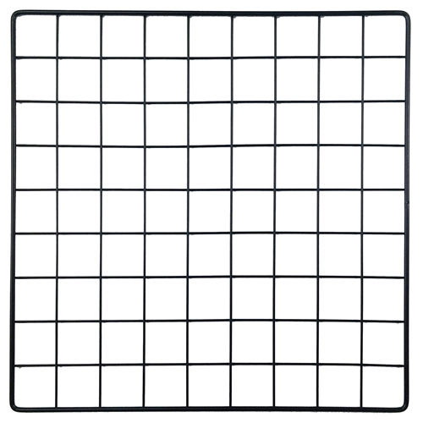
Implicit representations of edges
In some cases, we don’t need to use adjacency lists/maps to store the neighbors of a vertex. The neighbors can be dynamically calculated (by a getNeighbors function) when the need arises. This typically happens when the given graph is structured like a grid, with rows and columns of vertices.
This approach saves us space without sacrificing time.
E.g, City Map
Every vertex has 4 neighbors unless it is close to the grid boundary.
Notes:
The various representations for edges we discussed so far - edge lists, adjacency lists and maps and matrices -- all represented edges explicitly, by allocating a constant amount of memory space for each edge….

Slide 70
Problem: We assumed the graph is connected. If it is not connected, we need to check that all the edges belong to the same connected component.
Notes:
There was one issue which we glossed over when talking about determining whether an undirected graph is Eulerian or not. We assumed that the graph we are given is connected….
Otherwise we can have a graph with two disconnected triangles, and our code for Eulerian cycles/paths would return Yes.

Slide 71
For that, we need to find a way to explore (traverse) a graph starting from a source vertex s.
Find all reachable vertices from s.

Slide 72
Skeleton search
3
5
4
1
7
6
1
2
3
2
7
5
4
Captured
Yet to capture
6

Slide 73
Skeleton search
5
3
2
4
1
5
1
2
3
7
6
7
5
4
Captured
Yet to capture
6

Slide 74
Skeleton search
5
6
1
3
7
1
2
3
2
4
7
5
4
Captured
Yet to capture
6

Slide 75
Skeleton search
5
1
6
3
7
2
1
2
3
4
7
5
4
Captured
Yet to capture
6

Slide 76
Skeleton search
5
6
1
3
7
2
1
2
3
4
7
5
4
Captured
Yet to capture
6

Slide 77
Skeleton search
5
6
1
3
7
2
1
2
3
4
7
5
4
Captured
Yet to capture
6

Slide 78
Skeleton search
class Graph {
void search(int s) { //captured is an array initialized to 0 //for all vertices captured[s] = 1
} …...
}
s
Captured
Yet to capture

Slide 79
Skeleton search
class Graph {
void search(int s) { captured[s] = 1 while there exists a fringe edge: pick one of them => (u,v) captured[v] = 1
}
}
s
Captured
Yet to capture

Slide 80
Result
We get a search tree with root = source vertex s
The set of captured vertices = the set of reachable nodes from s
5
1
3
2
4
Captured

Slide 81
Keeping track of parents in search tree
class Graph {
void search(int s) { //captured and parent initialized to 0 and null
captured[s] = 1 while there exists a fringe edge: pick one of them => (u,v) captured[v] = 1 parent[v] = u
}
}
s
Captured
Yet to capture

Slide 82
captured
5
1 | 1 | 1 | 1 | 1 | 0 | 0
1
3
1 | 2 | 3 | 4 | 5 | 6 | 7
2
null | 1 | 2 | 2 | 1 | null | null
4
parent
Captured

Slide 83
Different policies
class Graph {
void search(int s) { //captured and parent initialized to 0 and null
captured[s] = 1 while there exists a fringe edge: pick one of them => (u,v) captured[v] = 1 parent[v] = u
}
}
s
Captured
Yet to capture

Slide 84
BFS & DFS
BFS policy: Among all fringe edges (u,v), pull the one which was examined first.
DFS policy: Among all fringe edges (u,v), pull the one which was examined last (i.e, most recently).

Slide 85
BFS
3
5
4
1
7
6
1
2
3
2
7
5
4
Captured
Yet to capture
6

Slide 86
BFS
3
5
4
1
7
6
1
2
3
2
7
5
4
Captured
Yet to capture
6

Slide 87
BFS
5
3
4
1
7
6
2
1
2
3
7
5
4
Captured
Yet to capture
6

Slide 88
BFS
3
5
4
1
7
6
2
1
2
3
7
5
4
Captured
Yet to capture
6

Slide 89
BFS
5
4
1
2
6
7
1
2
3
3
7
5
4
Captured
Yet to capture
6

Slide 90
BFS
5
1
4
2
6
7
1
2
3
3
7
5
4
Captured
Yet to capture
6

Slide 91
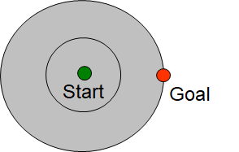

Slide 92
Modify the code for BFS
class Graph {
void BFS(int s) { //captured and parent initialized to 0 and null captured[s] = 1 while there exists a fringe edge: pick one of them => (u,v) captured[v] = 1 parent[v] = u
}
}
s
Captured
Yet to capture

Slide 93
BFS
class Graph {
void BFS(int s) { //visited, captured and parent initialized to 0, 0 and null captured[s] = 1; visited[s] = 1 q = new Queue(); q.push(s); while not isEmpty(q): //capture the next vertex v = q.pop() captured[v] = 1 for w in Adjlist[v]: if visited[w] == 0 then visited[w] = 1; parent[w] = v; q.push(w);
}
}
s
Captured
Yet to capture

Slide 94
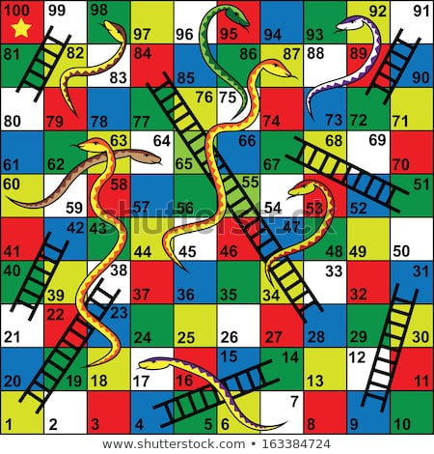
Given a snake and ladder game, find the minimum number of throws required to win the game.

Slide 95
Given n nodes labeled from 0 to n - 1 and a list of undirected edges (each edge is a pair of nodes), write a function to find the number of connected components in an undirected graph.

Slide 96
BFS
class Graph {
void BFS(int s, int c) { captured[s] = 1; visited[s] = c q = new Queue(); q.push(s); while not isEmpty(q): //capture the next vertex v = q.pop() captured[v] = 1 for w in Adjlist[v]: if visited[w] == 0 then visited[w] = c; parent[w] = v; q.push(w); }
}
void findComponents() { //visited, captured and parent are initialized to 0, 0 and null component = 0 for i in 1 to V: if visited[i] = 0: component++ //start new component BFS(i, component)
return component }
}

Slide 97
Eulerian cycle or path problem
Graph representations
General graph traversal
BFS
Dijkstra
Prim
DFS
Best-first
A*
bipartite
connected components

Slide 98
Different policies
class Graph {
void search(int s) { //captured and parent initialized to 0 and null
captured[s] = 1 while there exists a fringe edge: pick one of them => (u,v) captured[v] = 1 parent[v] = u
}
}
s
Captured
Yet to capture

Slide 99
Graphs live class

Slide 100

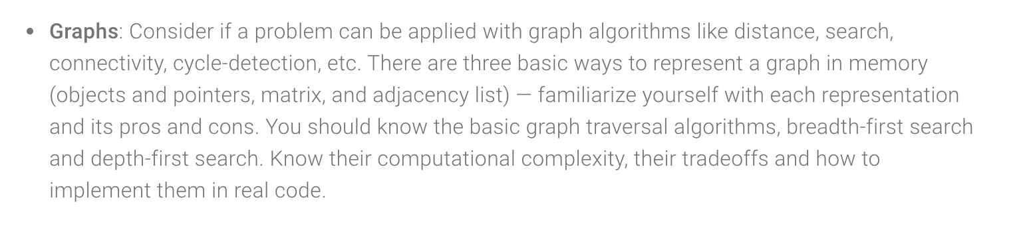
https://careers.google.com/how-we-hire/interview/#interviews-for-software-engineering-and-technical-roles

Slide 101

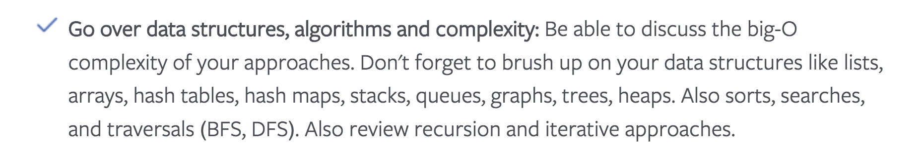
https://www.facebook.com/careers/life/preparing-for-your-software-engineering-interview-at-facebook/

Slide 102

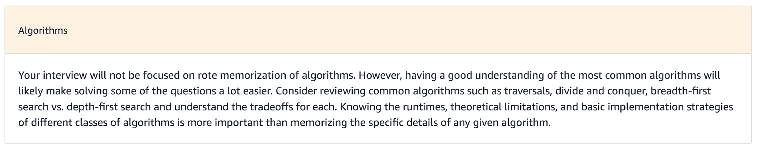
https://www.amazon.jobs/en/landing_pages/in-software-development-topics

Slide 103
Basic Graph Theory
IK Graphs curriculum
Graph representations
General graph traversal
BFS
DFS
Dijkstra
Prim
Best-first
A*
Shortest paths
Traversals of undirected and directed graphs
Finding connected components
Detecting cycles
Bipartite
top.sort
Bellman-Ford
Floyd-Warshall
Kruskal
SCC etc.

Slide 104
Basic Graph Theory
Foundation & Live class
Graph representations
Extension I
Extension II
General graph traversal
BFS
DFS
Dijkstra
Prim
Best-first
A*
Shortest paths
Traversals of undirected and directed graphs
Finding connected components
Detecting cycles
Bipartite
top.sort
Bellman-Ford
Floyd-Warshall
Kruskal
SCC etc.

Slide 105
General Graph Traversal
Given this directed graph, which vertices are reachable from vertex 1?
3
5
4
1
7
6
1
2
3
2
7
5
4
Pulled out
Undiscovered
6

Slide 106
General Graph Traversal
Initially, all the vertices are unreachable. They lie undiscovered, like fish swimming deep inside an ocean.
3
5
4
1
7
6
1
2
3
2
7
5
4
Pulled out
Undiscovered
6

Slide 107
We do have one vertex that is reachable though, and that is the source vertex.
3
5
4
1
7
6
1
2
3
2
7
5
4
Pulled out
Undiscovered
6

Slide 108
Like a fish caught inside a fishing net/bag.
3
5
4
1
7
6
1
2
3
2
7
5
4
Pulled out
Undiscovered
6

Slide 109
Now it has been pulled out of the bag, and brought ashore.
3
5
4
1
7
6
1
2
3
2
7
5
4
Pulled out
Undiscovered
6

Slide 110
But it has these “hooks” (relationships) connecting it to neighbors that were so far undiscovered, but which now become reachable. We put them into the bag.
5
3
2
4
1
5
1
2
3
7
6
7
5
4
Pulled out
Undiscovered
6

Slide 111
We now pull another vertex out of the bag.
5
3
2
4
1
5
1
2
3
7
6
7
5
4
Pulled out
Undiscovered
6

Slide 112
5
6
1
3
7
1
2
3
2
4
7
5
4
Pulled out
Undiscovered
6

Slide 113
Look at the neighbors of 2. If any of them was undiscovered, they are now reachable, so put them into the bag.
5
6
1
3
7
1
2
3
2
4
7
5
4
Pulled out
Undiscovered
6

Slide 114
Choose the next vertex that will be pulled out of the bag.
5
6
1
3
7
1
2
3
2
4
7
5
4
Pulled out
Undiscovered
6

Slide 115
Vertex 4 has no undiscovered neighbors, so no new additions to the bag.
5
1
6
3
7
2
1
2
3
4
7
5
4
Pulled out
Undiscovered
6

Slide 116
Choose the next vertex that will be pulled out of the bag.
5
1
6
3
7
2
1
2
3
4
7
5
4
Pulled out
Undiscovered
6

Slide 117
5
6
1
3
7
2
1
2
3
4
7
5
4
Pulled out
Undiscovered
6

Slide 118
No additions to the bag
5
6
1
3
7
2
1
2
3
4
7
5
4
Pulled out
Undiscovered
6

Slide 119
Choose the next vertex that will be pulled out of the bag.
5
6
1
3
7
2
1
2
3
4
7
5
4
Pulled out
Undiscovered
6

Slide 120
5
6
1
3
7
2
1
2
3
4
7
5
4
Captured
Undiscovered
6

Slide 121
Now the bag is empty!
5
6
1
3
7
2
1
2
3
4
7
5
4
Captured
Undiscovered
6

Slide 122
Result
We get a search tree with root = source vertex s
The vertices in it are the set of reachable nodes from s
If a vertex c was pulled out of the bag by vertex p, then p is the parent of c in the search tree
5
1
3
2
4

Slide 123
Pseudocode for General Graph Traversal

Slide 124
General Graph Traversal algorithm
Initialization: All vertices are undiscovered
void GeneralSearch(Vertex s):
s

Slide 125
General Graph Traversal algorithm
Initialization: All vertices are undiscovered
void GeneralSearch(Vertex s): Initialize an empty bag and put s in it Mark s as discovered
s

Slide 126
General Graph Traversal algorithm
Initialization: All vertices are undiscovered
void GeneralSearch(Vertex s): Initialize an empty bag and put s in it Mark s as discovered while the bag is not empty: ???
s

Slide 127
Fast forward to a general point...

Slide 128
General Graph Traversal algorithm
Initialization: All vertices are undiscovered
void GeneralSearch(Vertex s): Initialize an empty bag and put s in it Mark s as discovered while the bag is not empty: ???
s
u

Slide 129
General Graph Traversal algorithm
Initialization: All vertices are undiscovered
void GeneralSearch(Vertex s): Initialize an empty bag and put s in it Mark s as discovered while the bag is not empty: Pull out one of the vertices, say u
s
u

Slide 130
General Graph Traversal algorithm
Initialization: All vertices are undiscovered
void GeneralSearch(Vertex s): Initialize an empty bag and put s in it Mark s as discovered while the bag is not empty: Pull out one of the vertices, say u
s
u
p

Slide 131
General Graph Traversal algorithm
Initialization: All vertices are undiscovered
void GeneralSearch(Vertex s): Initialize an empty bag and put s in it Mark s as discovered while the bag is not empty: Pull out one of the vertices, say u
s
p
u

Slide 132
General Graph Traversal algorithm
Initialization: All vertices are undiscovered
void GeneralSearch(Vertex s): Initialize an empty bag and put s in it Mark s as discovered while the bag is not empty: Pull out one of the vertices, say u
v
s
s
u
p
w
u

Slide 133
General Graph Traversal algorithm
Initialization: All vertices are undiscovered
void GeneralSearch(Vertex s): Initialize an empty bag and put s in it Mark s as discovered while the bag is not empty: Pull out one of the vertices, say u For each neighbor of u: if the neighbor is undiscovered:
v
s
u
w

Slide 134
General Graph Traversal algorithm
Initialization: All vertices are undiscovered
void GeneralSearch(Vertex s): Initialize an empty bag and put s in it Mark s as discovered while the bag is not empty: Pull out one of the vertices, say u For each neighbor of u: if the neighbor is undiscovered: put the neighbor in the bag mark it as discovered
v
s
u
w

Slide 135
Life cycle of a vertex
Every vertex (except s) starts out undiscovered
void GeneralSearch(Vertex s): Initialize an empty bag and put s in it Mark s as discovered while the bag is not empty: Pull out one of the vertices, say u For each neighbor of u: if the neighbor is undiscovered: put the neighbor in the bag mark it as discovered
v

Slide 136
Life cycle for a vertex
At some point, it is discovered and added to the bag
void GeneralSearch(Vertex s): Initialize an empty bag and put s in it Mark s as discovered while the bag is not empty: Pull out one of the vertices, say u For each neighbor of u: if the neighbor is undiscovered: put the neighbor in the bag mark it as discovered
v

Slide 137
Life cycle of a vertex
And then there comes a point…
void GeneralSearch(Vertex s): Initialize an empty bag and put s in it Mark s as discovered while the bag is not empty: Pull out one of the vertices, say u For each neighbor of u: if the neighbor is undiscovered: put the neighbor in the bag mark it as discovered
v

Slide 138
Life cycle of a vertex
...when it is pulled out of the bag and moved into the search tree on the left
void GeneralSearch(Vertex s): Initialize an empty bag and put s in it Mark s as discovered while the bag is not empty: Pull out one of the vertices, say u For each neighbor of u: if the neighbor is undiscovered: put the neighbor in the bag mark it as discovered
v

Slide 139
How do we maintain the collection of vertices in the bag?
If we use a FIFO Queue to store the vertices, we get BFS.
If we use a LIFO Stack to store the vertices, we get DFS.
If we use a Priority Queue to store the vertices, then each vertex is inserted into the bag with some priority. The vertex that is next pulled out of the bag is the one with the highest priority. Depending on how the priority is defined, we get Dijkstra’s algorithm, Prim’s algorithm or Best-first/A*.

Slide 140
Basic Graph Theory
All of these are variations of the General Graph traversal algorithm.
Graph representations
General graph traversal
BFS
DFS
Dijkstra
Prim
Best-first
A*
Shortest paths
Traversals of undirected and directed graphs
Finding connected components
Detecting cycles
Bipartite
top.sort
Bellman-Ford
Floyd-Warshall
Kruskal
SCC etc.

Slide 141
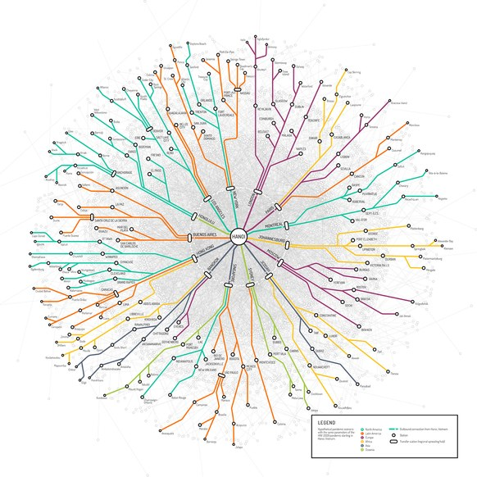
BFS

Slide 142
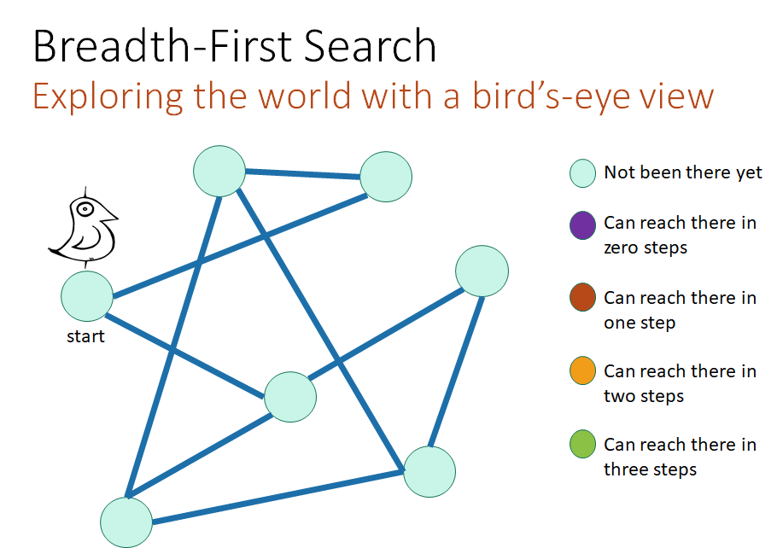
(Undirected graph example)
(Few slides adapted from Mary Wootters, CS161 @ Stanford)

Slide 143
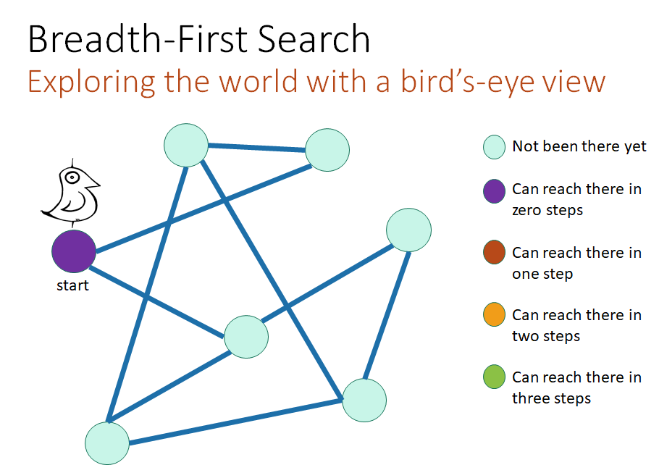

Slide 144
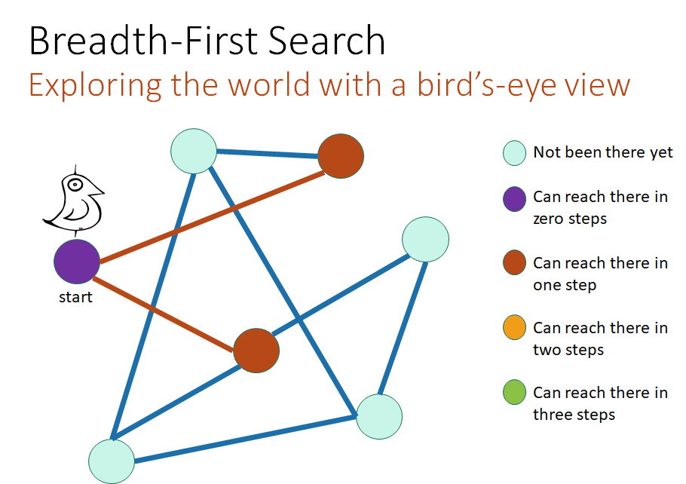

Slide 145
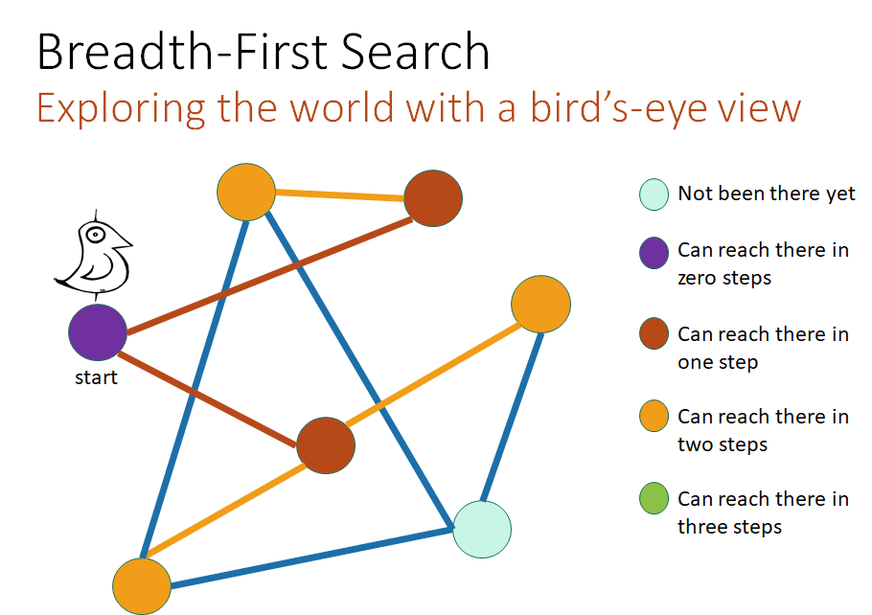

Slide 146
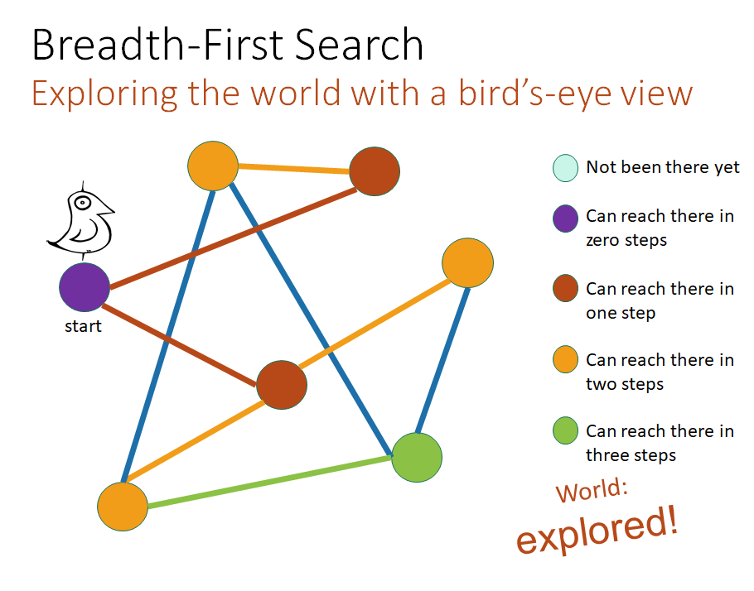

Slide 147
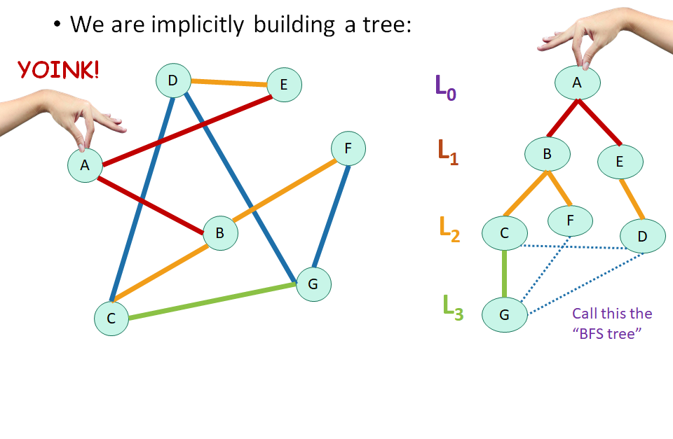
Tree edge
Cross edge
Notice layer partitioning.
Can we have cross edges skipping a layer?

Slide 148
BFS
Vertices are visited in increasing order of distance from source s.
class Graph {
void BFS(int s) { //visited and parent initialized to 0 and null visited[s] = 1 q = new Queue(); q.push(s); while not isEmpty(q): v = q.pop() for w in Adjlist[v]: if visited[w] == 0 then visited[w] = 1; parent[w] = v; q.push(w);
}
}
s
Captured
Yet to capture

Slide 149
S
DFS

Slide 150
S

Slide 151
S

Slide 152
S

Slide 153
S

Slide 154
S

Slide 155
4
5
3
S
1
2

Slide 156
S
Tree edge
1
Back edge
2
3
4
5

Slide 157
class Graph { …..
//adjList is an array of lists
void DFS(int source) { visited[source] = 1 for neighbor in adjList[source]: if visited[neighbor] == -1: DFS(neighbor) }
}

Slide 158
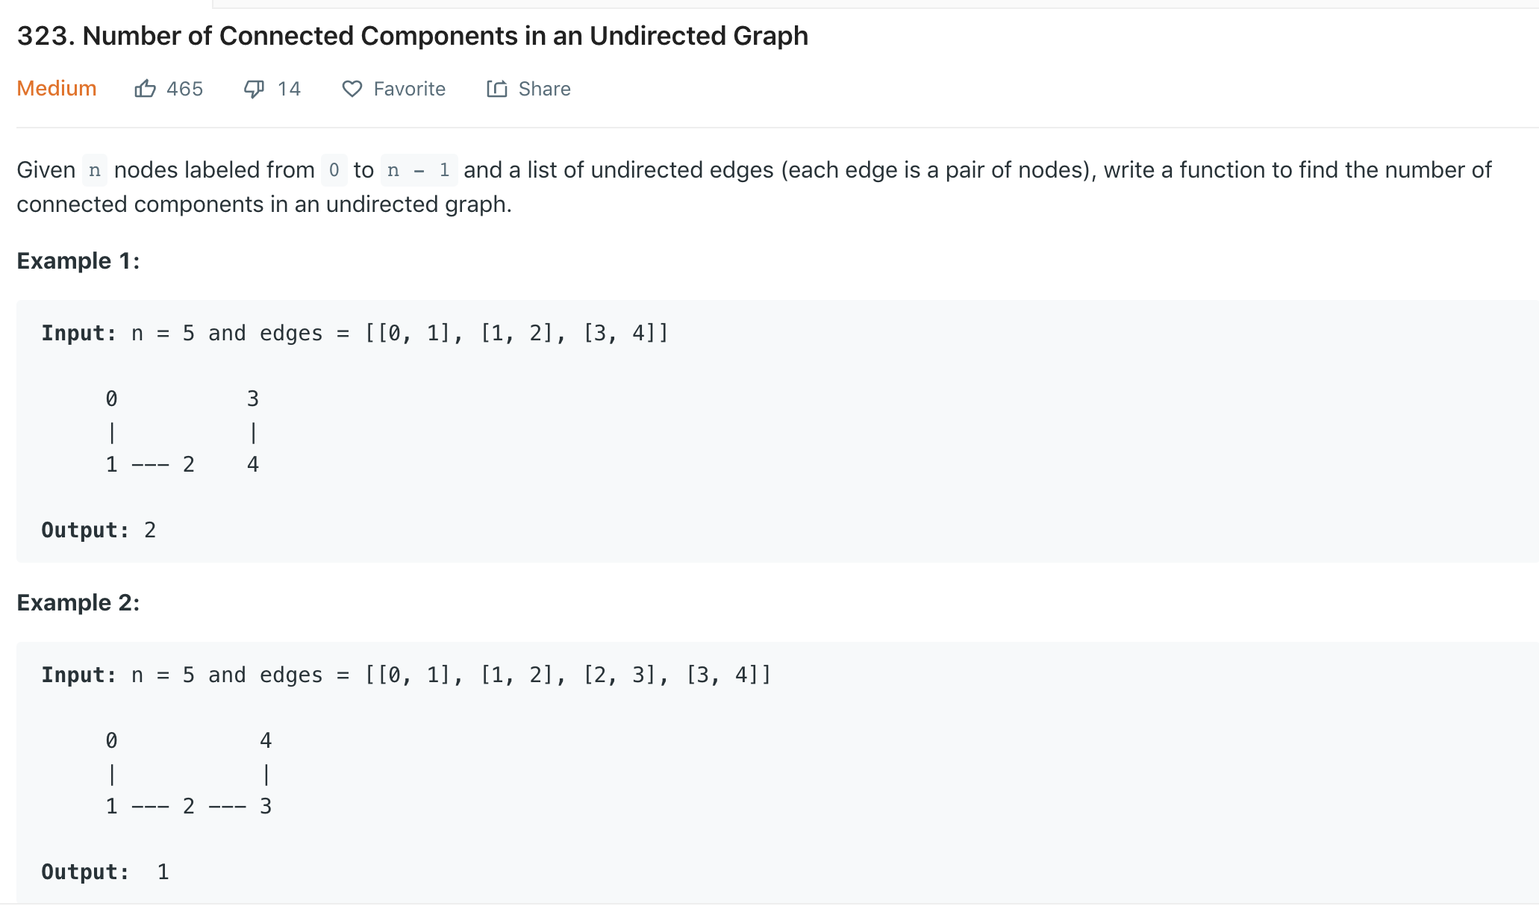

Slide 159
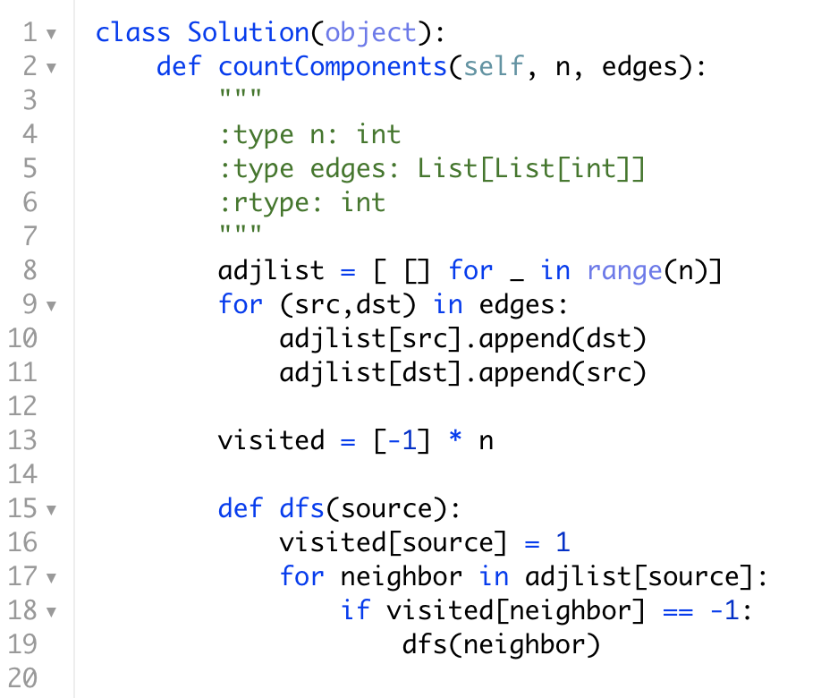

Slide 160
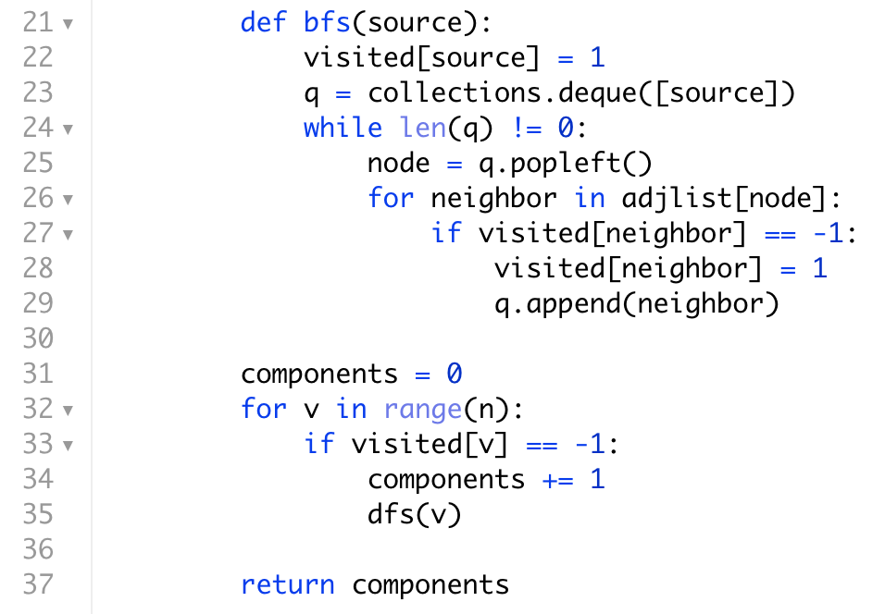

Slide 161
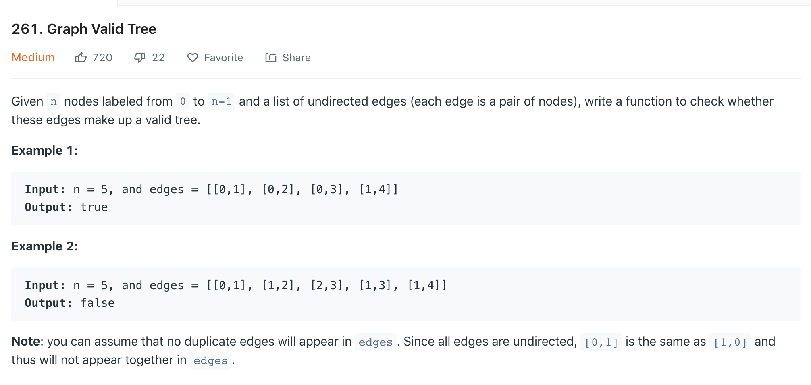

Slide 162
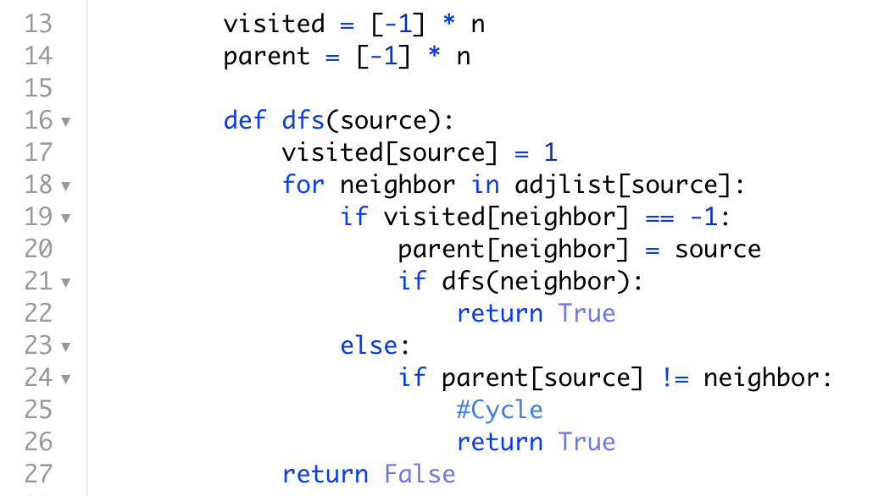

Slide 163
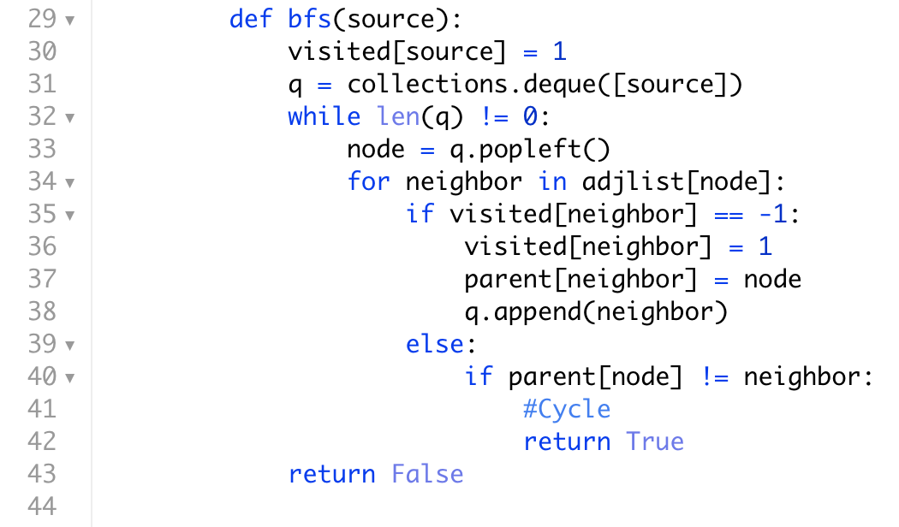

Slide 164
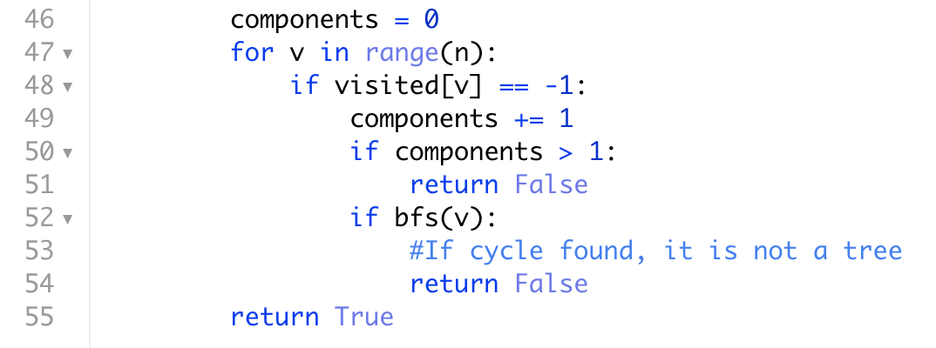

Slide 165
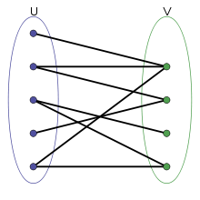
Given an undirected graph, return true if and only if it is bipartite.
Recall that a graph is bipartite if we can split its set of nodes into two independent subsets A and B such that every edge in the graph has one node in A and another node in B.
A
B
Notes:
BFS on undirected graphs is useful for computing shortest paths and connected components.
Also useful for determining whether a graph is bipartite or not.
Start from source s, put it in partition A. Put all its neighbors in partition B. Put its undiscovered neighbors in partition A. Continue in this manner.
Problem: If there is a cross edge between two vertices in the same level. It’s ok for cross edges to go to next or previous level. But not at the same level.
Cross edges within the same level create an odd length cycle.
Why can’t a bipartite graph have an odd length cycle?
All cycles must be of even length.

Slide 166
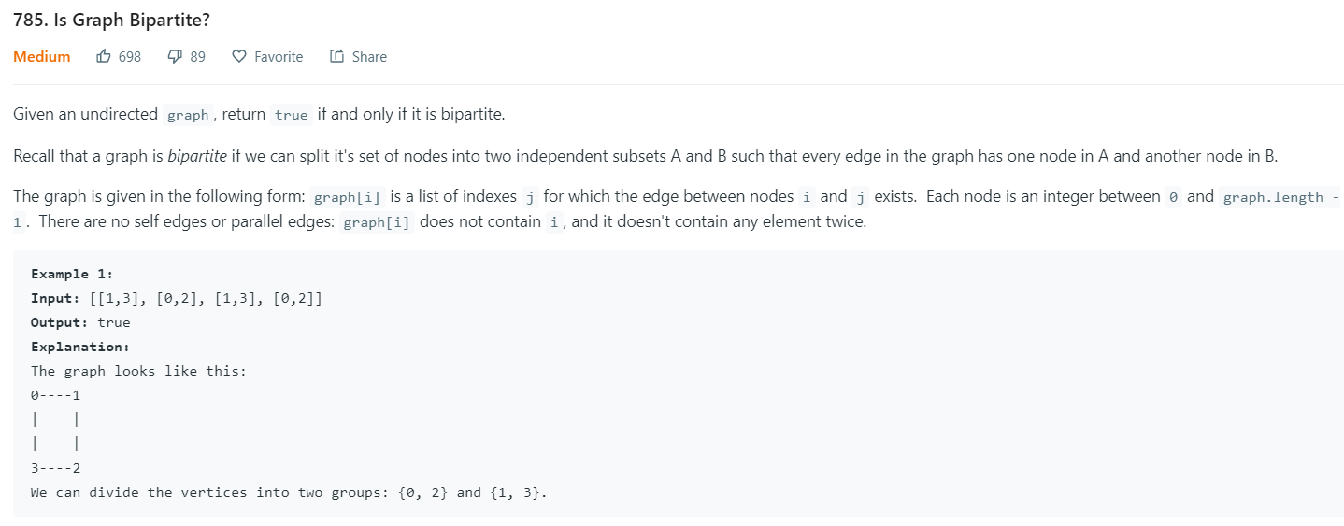

Slide 167
Can the vertices of a given graph G be colored using only two colors so that adjacent vertices have different colors?

Slide 168
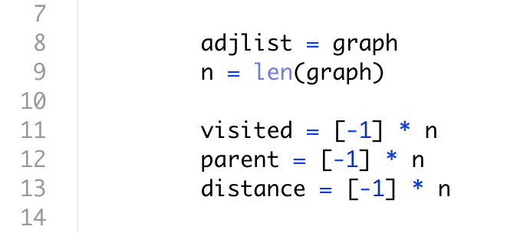

Slide 169
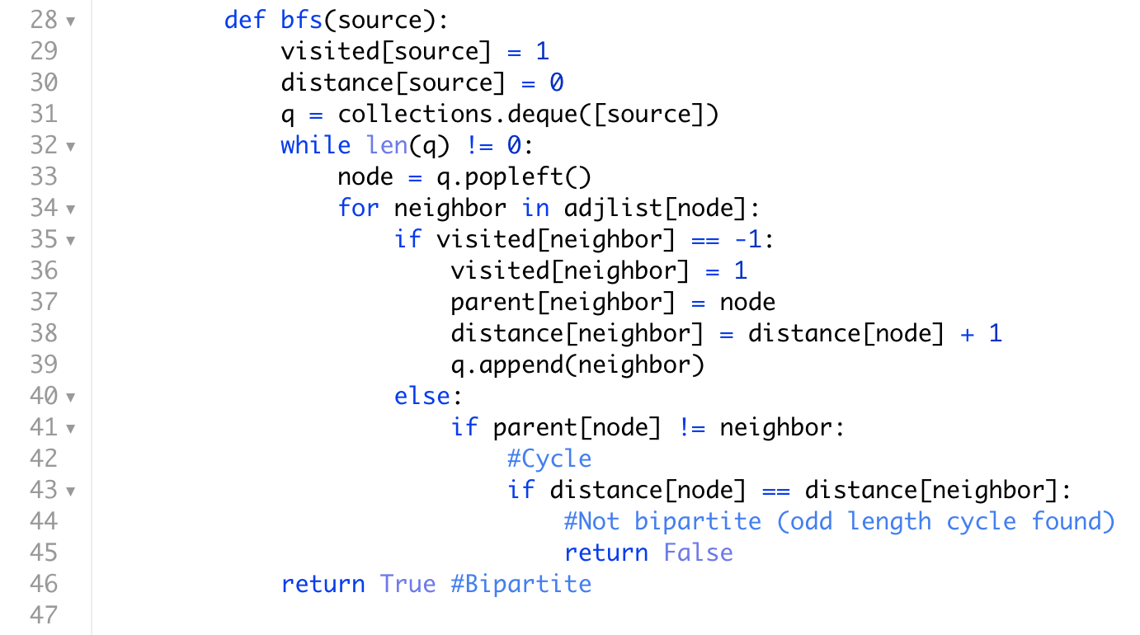

Slide 170
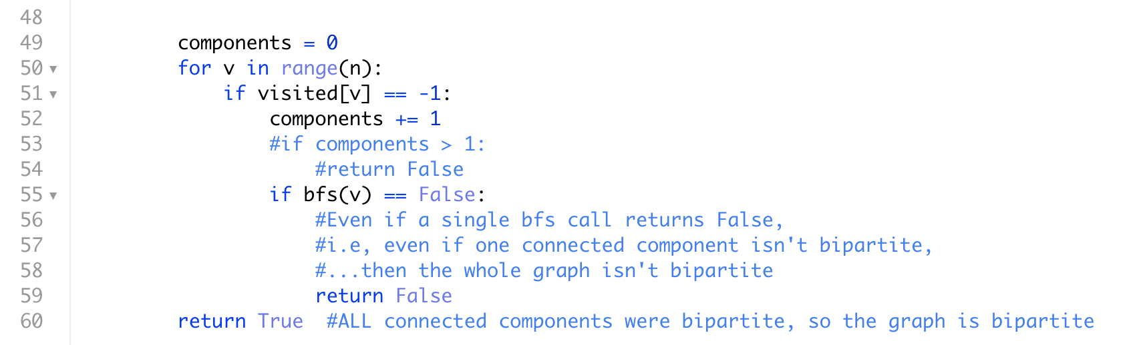

Slide 171
BFS
Vertices are captured in increasing order of distance from source s.
class Graph {
void BFS(int s) { //visited, captured and parent initialized to 0, 0 and null captured[s] = 1; visited[s] = 1 q = new Queue(); q.push(s); while not isEmpty(q): //capture the next vertex v = q.pop() captured[v] = 1 for w in Adjlist[v]: if visited[w] == 0 then visited[w] = 1; parent[w] = v; q.push(w);
}
}
s
Captured
Yet to capture

Slide 172
BFS
class Graph {
void BFS(int s) { //d, visited, captured and parent initialized to INF, 0, 0 and null d[s] = 0; captured[s] = 1; visited[s] = 1 q = new Queue(); q.push(s); while not isEmpty(q): //capture the next vertex v = q.pop() captured[v] = 1 for w in Adjlist[v]: if visited[w] == 0 then visited[w] = 1; parent[w] = v; d[w] = d[v] + 1 q.push(w); else if d[w] == d[v] then graph is not bipartite //Conclusion: Graph is bipartite
}
}
s
Captured
Yet to capture
Notes:
This assumes the graph is connected. Otherwise have to check if each connected component is bipartite

Slide 173
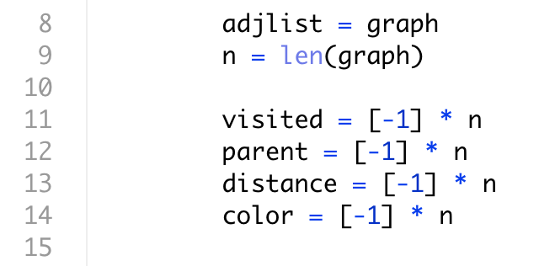

Slide 174
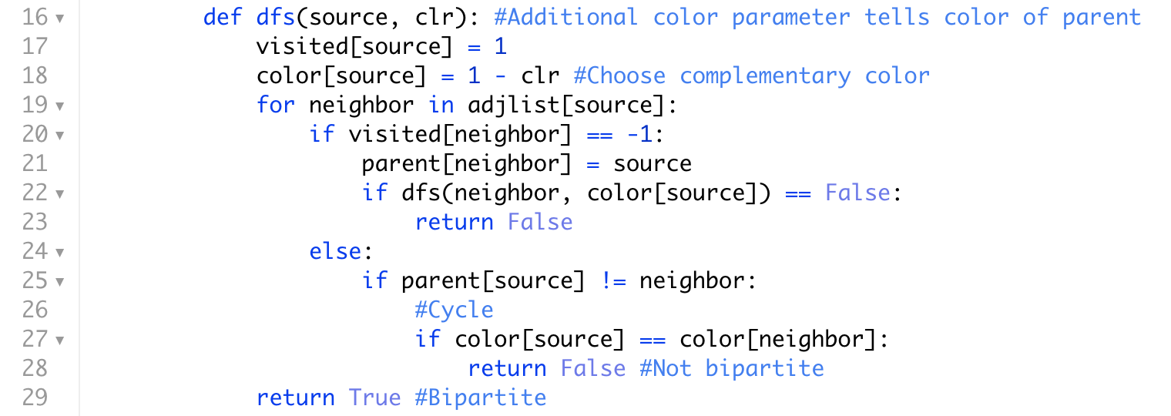

Slide 175
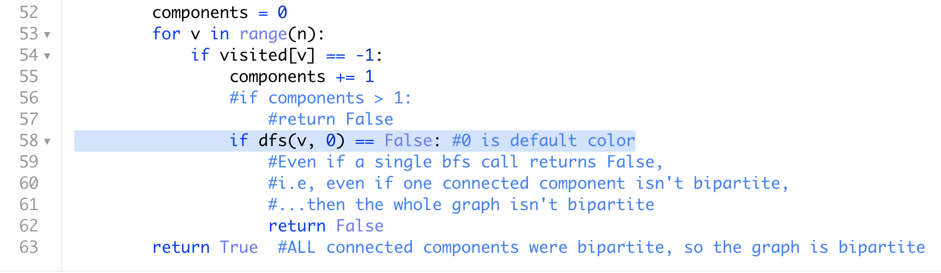

Slide 176
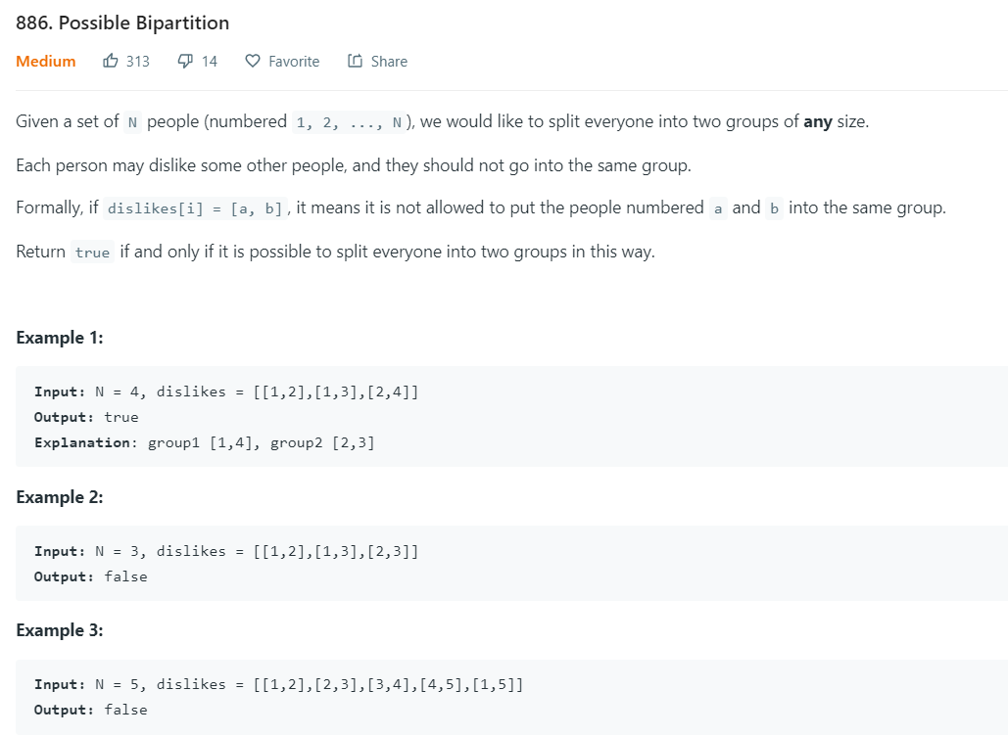

Slide 177


OR

Slide 178


Slide 179


Slide 180


Slide 181
Note: Set grid[x][y] = 0 when (x,y) is visited, not when it is captured. Otherwise, the queue size can become very large, with duplicate entries packed inside, and you would get a “time limit exceeded” issue on online coding platforms.

Slide 182


Slide 183


Slide 184
Implicit representations of edges
In some cases, we don’t need to use adjacency lists/maps to store the neighbors of a vertex. The neighbors can be dynamically calculated (by a getNeighbors function) when the need arises. This typically happens when the given graph is structured like a grid, with rows and columns of vertices.
This approach saves us space without sacrificing time.
E.g, City Map
Every vertex has 4 neighbors unless it is close to the grid boundary.
Notes:
The various representations for edges we discussed so far - edge lists, adjacency lists and maps and matrices -- all represented edges explicitly, by allocating a constant amount of memory space for each edge….

Slide 185

The Flood Fill problem
http://jeffe.cs.illinois.edu/teaching/algorithms/book/05-graphs.pdf

Slide 186
Given: 1) A 2D array of integer values, where the values represent colors, 2) the coordinates of the starting pixel, and 3) the value of the new color:
Implement the flood fill operation.
http://jeffe.cs.illinois.edu/teaching/algorithms/book/05-graphs.pdf

Slide 187

http://jeffe.cs.illinois.edu/teaching/algorithms/book/05-graphs.pdf

Slide 188

http://jeffe.cs.illinois.edu/teaching/algorithms/book/05-graphs.pdf

Slide 189
General Graph Traversal algorithm
Initialization: All vertices are undiscovered
void GeneralSearch(Vertex s): Initialize an empty bag and put s in it Mark s as discovered while the bag is not empty: Pull out one of the vertices, say u For each neighbor of u: if the neighbor is undiscovered: put the neighbor in the bag mark it as discovered

Slide 190
General Graph Traversal algorithm
void BFS(Vertex s): q = new Queue([s]) grid[s] = newColor while q is not empty: u = q.pop() for neighbor in getNeighbors(u): if grid[neighbor] == oldColor: q.push(neighbor) grid[neighbor] = newColor
bfs(sx,sy) return grid

Slide 191
y
def getNeighbors(x,y): result = empty array if x+1 <= length(grid)-1: result.append((x+1,y)) if y+1 <= length(grid[0])-1: result.append((x,y+1)) if x-1 >= 0: result.append((x-1,y)) if y-1 >= 0: result.append((x,y-1)) return result
x

Slide 192
What if the Queue was replaced by a Stack?
Edge case: if oldColor == newColor: return grid

Slide 193
From undirected to directed graphs...

Slide 194
BFS (Directed graph example)
1
2
3
7
8
5
4
Is it straightforward to detect if a directed graph has a cycle by looking at the BFS tree? When would you do BFS on a directed graph?
6
Notes:
Source node is 1. Draw the resulting BFS tree.
Tree edges, cross edges, back edges.
Distinguishing between whether a given edge to a visited node is cross edge or back edge isn’t possible unless you look at all ancestors back up.
So BFS on directed graphs only useful for calculating shortest number of hops from source to various vertices in a directed graph.

Slide 195
Given a snake and ladder game, find the minimum number of throws required to win the game.

Slide 196


Slide 197


Slide 198
How do we find the shortest path from source s to some destination when there are lengths (weights) on edges? BFS is a special case of this problem where all weights are 1.
Analogy: Think of how a disease spreads in a population.

Slide 199
A
2
2
S
5
B

Slide 200
•What if the graphs are weighted?
•All nonnegative weights: Dijkstra
•If there are negative weights: Bellman-Ford

Slide 201
DFS with a little bookkeeping...

Slide 202
class Graph { …..
//adjList is an array of lists
void DFS(int source) { visited[source] = 1 for neighbor in adjList[source]: if visited[neighbor] == -1: DFS(neighbor) }
}

Slide 203
class Graph { time = 0 //arr, dep are two arrays recording arrival and departure times of each vertex; initialized to -1
void DFS(int source) { visited[source] = 1 arr[source] = time++ for neighbor in adjList[source]: if visited[neighbor] == -1: DFS(neighbor) dep[source] = time++ }
}

Slide 204
S

Slide 205
S
0/

Slide 206
S
0/
1/

Slide 207
S
0/
1/
2/

Slide 208
S
0/
1/
2/3

Slide 209
4/
S
0/
1/
2/3

Slide 210
5/
4/
S
0/
1/
2/3

Slide 211
5/6
4/
S
0/
1/
2/3

Slide 212
5/6
7/
4/
S
0/
1/
2/3

Slide 213
5/6
7/8
4/
S
0/
1/
2/3

Slide 214
5/6
7/8
4/9
S
0/
1/
2/3

Slide 215
5/6
7/8
4/9
S
0/
1/10
2/3

Slide 216
5/6
7/8
4/9
S
0/11
1/10
2/3

Slide 217
S
0/11
1/10
2/3
4/9
5/6
7/8

Slide 218
S
0/11
Tree edge
1/10
Back edge
2/3
4/9
5/6
7/8

Slide 219
Notice the relationship between arrival and departure times of ancestors and descendants?

Slide 220
We have already seen how to find cycles in an undirected graph (using BFS/DFS). How do we find cycles in a directed graph?
Don’t use BFS! Why?
Notes:
We won’t use BFS to test for cycles in directed graphs, as it’s not easy to distinguish cross edges from back edges.

Slide 221
DFS on Directed graphs

Slide 222
S

Slide 223
0/
S

Slide 224
0/
S
1/

Slide 225
0/
S
1/
2/

Slide 226
0/
S
1/
2/

Slide 227
0/
S
1/
2/3

Slide 228
0/
S
1/
4/
2/3

Slide 229
0/
S
1/
4/
2/3
5/

Slide 230
0/
S
1/
4/
2/3
5/

Slide 231
0/
S
1/
4/
2/3
5/6

Slide 232
0/
S
1/
4/7
2/3
5/6

Slide 233
0/
S
1/8
4/7
2/3
5/6

Slide 234
0/
S
1/8
4/7
2/3
5/6

Slide 235
0/9
S
1/8
4/7
2/3
5/6

Slide 236
0/9
S
10/
1/8
4/7
2/3
5/6

Slide 237
0/9
S
10/
1/8
4/7
2/3
5/6

Slide 238
0/9
S
10/11
1/8
4/7
2/3
5/6

Slide 239
0/9
S
10/11
1/8
2/3
4/7
5/6

Slide 240
0/9
S
10/11
Tree edge
Back edge
Forward edge
1/8
Cross edge
2/3
4/7
5/6

Slide 241


Slide 242
Imagine starting from the root and tumbling down tree edges, forward edges and going across cross edges. What is happening to the departure times?

Slide 243
Only back edges create a cycle.
Tree edges, forward edges and cross edges always go from bigger to smaller departure times. To go from a smaller to bigger departure time, need a back edge.
So a directed graph has no cycle iff there is no back edge in its DFS tree.

Slide 244
But how does one detect a back edge? Can it be done in a single DFS pass?

Slide 245
class Graph { time = 0 //arr, dep are two arrays recording arrival and departure times of each vertex; initialized to -1
void DFS(int source) { visited[source] = 1 arr[source] = time++ for neighbor in adjList[source]: if visited[neighbor] == 0: // (source,neighbor) is a tree edge DFS(neighbor) else: //visited[neighbor] == 1 if departure time of neighbor is not yet set: //back edge elif arr[source] < arr[neighbor]: //and departure time of neighbor is set //forward edge else: // arr[source] > arr[neighbor] and departure time of neighbor is set //cross edge dep[source] = time++ }
}

Slide 246


Slide 247

Is it possible to get your degree?

Slide 248


Slide 249


Slide 250


Slide 251
Given a directed acyclic graph G, we can order the vertices of G so that every edge goes from left to right. This ordering is called a topological sort.

Slide 253


Slide 254


Slide 255


Slide 256


Slide 257


Slide 258


Slide 259
Alternate method (Kahn)
Calculate and maintain an in-degree array for each vertex. Keep all vertices with zero in-degree in a queue/stack. If graph is a DAG, there must exist a vertex with zero indegree. Make it the first vertex in the topological sort, and delete all its outgoing edges (which means update in-degree array by decrementing the in-degree counts). If any new vertex with in-degree count 0 is found, add it to the queue/stack. Repeat until all vertices in the graph are sorted.
Doable in O(V+E)?

Slide 260
Defunct slides

Slide 261
//initialize a “departure_times” array of size 2V to 0. bool hasCycle(int v) { flag = false visited[v] = 1 arr[v] = time++ for w in adjList[v]: if visited[w] == 0: // v,w is a tree edge flag = flag or DFS(w) else: //visited[w] == 1 If a back edge is detected: flag = true dep[v] = time++ departure_times[dep[v]] = v return flag }
Just sort the vertices in decreasing order of departure times. Can do it by maintaining a stack, and pushing every vertex into it at the time of departure from that vertex.
Alternate method: See pseudocode to the left (and next slide)
Method 3: Calculate and maintain an in-degree array for each vertex. Keep all vertices with zero in-degree in a queue/stack. If graph is a DAG, there must exist a vertex with zero indegree. Make it the first vertex in the topological sort, and delete all its outgoing edges (which means update in-degree array by decrementing the in-degree counts). If any new vertex with in-degree count 0 is found, add it to the queue/stack. Repeat until all vertices in the graph are sorted.

Slide 262
//initialize a “departure_times” array of size 2V to 0. This will record which vertex had that departure time bool hasCycle(int v) { flag = false visited[v] = 1 arr[v] = time++ for w in adjList[v]: if visited[w] == 0: // v,w is a tree edge flag = flag or DFS(w) else: //visited[w] == 1 if arr[v] < arr[w] and dep[v] > dep[w]: //forward edge if arr[v] > arr[w] and dep[v] < dep[w]: flag = true //back edge if arr[w] < dep[w] < arr[v] < dep[v]: //cross edge dep[v] = time++ departure_times[dep[v]] = v return flag }
topsort = new List(); for t in 2V down to 1: if departure_times[t] != 0: topsort.append(departure_times[t])
//topsort now contains the topologically sorted list of vertices

Slide 263

A robot is located at the top-left corner of a m x n grid (marked 'Start' in the diagram below).
The robot can only move either down or right at any point in time. The robot is trying to reach the bottom-right corner of the grid (marked 'Finish' in the diagram below).
How many possible unique paths are there?

Slide 264
//initialize a “departure_times” array of size 2V to 0. This will record which vertex had that departure time bool hasCycle(int v) { flag = false visited[v] = 1 arr[v] = time++ for w in adjList[v]: if visited[w] == 0: // v,w is a tree edge flag = flag or DFS(w) else: //visited[w] == 1 if arr[v] < arr[w] and dep[v] > dep[w]: //forward edge if arr[v] > arr[w] and dep[v] < dep[w]: flag = true //back edge if arr[w] < dep[w] < arr[v] < dep[v]: //cross edge dep[v] = time++ departure_times[dep[v]] = v return flag }
//Initialize array “numpaths” to 0 to record //number of paths to goal vertex out of v //numpaths[goal] = 1 topsort = new List(); for t in 2V down to 1: if departure_times[t] != 0: topsort.append(departure_times[t]) //Let v = departure_times[t] for w in adjList[v]: numpaths[v] += numpaths[w]
//numpaths[1] will tell you number of paths from start vertex to goal vertex

Slide 265
Find the longest path in a DAG with weighted edges.
How about shortest path from a source node s?
Notes:
Both can be done in linear time, relying on topological sorting.

Slide 266
If G is not a DAG, then it has some cycles. The vertices within a cycle are mutually reachable. They are in the same strongly connected component.

Slide 270
DAG of strongly connected components

Slide 271
Given a directed graph G, is it strongly connected?

Slide 272
1
2
1
2
4
3
4
3

Slide 273
1
2
1
2
4
3
4
3
5
6

Slide 274
If DFS(v) visits all vertices in G, there exists a path from v to every vertex in G.
Suppose there also exists a path from every vertex in G to v. Is G strongly connected?

Slide 275
How do we determine that there exists a path from every vertex in G to v?

Slide 276
Method 1: In reverse(G), there should exist a path from v to every vertex in G.

Slide 277
Method 2: Use arrival times.

Slide 278
There should exist an edge (back or cross) going out of every subtree.

Slide 279
Make DFS(v) return the node with the smallest arrival time to which there is an edge from the subtree rooted at v.

Slide 280
class Graph { time = 0 //arr, dep are two arrays recording arrival and departure times of each vertex; initialized to -1
void DFS(int v) { visited[v] = 1 arr[v] = time++ for w in adjList[v]: if visited[w] == 0: // v,w is a tree edge DFS(w) else: //visited[w] == 1 if arr[v] < arr[w] and dep[v] > dep[w]: //forward edge if arr[v] > arr[w] and dep[v] < dep[w]: //back edge (but exclude edge to parent!) if arr[w] < dep[w] < arr[v] < dep[v]: //cross edge dep[v] = time++ }
}

Slide 281
class Graph { time = 0; flag = true //arr, dep are two arrays recording arrival and departure times of each vertex; initialized to -1
int DFS(int v) { visited[v] = 1 arr[v] = time++ sat = arr[v] //smallest arrival time to any node from this subtree. for w in adjList[v]: if visited[w] == 0: // v,w is a tree edge sat = min(sat, DFS(w)) else: //visited[w] == 1 if arr[v] < arr[w] and dep[v] > dep[w]: //forward edge if arr[v] > arr[w] and dep[v] < dep[w]: sat = min(sat, DFS(w)) //back edge if arr[w] < dep[w] < arr[v] < dep[v]: sat = min(sat, DFS(w)) //cross edge dep[v] = time++; if sat == arr[v] then flag = false; //but ok for root to have sat == arr[v] }
}

Slide 282
Given an undirected graph G, does it have a bridge?
Does it have an articulation point?

Slide 283
Find all strongly connected components of a directed graph G.

Slide 284
Kosaraju’s algorithm
Do a DFS on G and mark the departure times (or finish times) of all the vertices. (This may involve multiple DFS calls from unvisited vertices)
Reverse all edges to create a new graph G_{r}
Do a DFS on G_{r} with new DFS calls initiated on vertices in decreasing order of departure times in step 1.
Every DFS tree will be a strongly connected component in the original graph G.

Slide 285
Uninformed search:
Explores options in every “direction”
No information about goal location
Informed search:
Uses a heuristic For any search problem, you know the goal. Now, you have an idea of how far away you are from the goal.
https://inst.eecs.berkeley.edu/~cs188/sp19/

Slide 286

A heuristic is:
A function that estimates how close a state is to a goal
Designed for a particular search problem
Examples: Manhattan distance, Euclidean distance for pathing

Slide 287


Slide 288

Best-first search
Strategy: expand a node that you think is closest to a goal state

Slide 289
Dijkstra orders by path cost, or backward cost g(n)
Best-first orders by goal proximity, or forward cost h(n)
A* Search orders by the sum: f(n) = g(n) + h(n)

Slide 290


Slide 291


Slide 292


Slide 293
Objects and Pointers
When you implement a Graph, one popular way to implement it is by having a Vertex class with several member variables, and one of them is a pointer to a list of neighboring Vertices.
This is different from what we saw for pure adjacency lists. In the pure Adjacency list implementation, no vertex attributes are being stored in the structure.
In the "Objects and Pointers" approach, the vertex objects can have a bunch of attributes, and a pointer to the list of neighbors is just one of the attributes. For example, if you create a transportation graph with vertices as cities and edges as roads connecting cities, then for a city like San Francisco, you may want to store population size, area, elevation above sea level, annual rainfall and other attributes. You're not just storing the neighboring cities. Think about how/where you will store these attributes.
Notes:
Google’s interview package letter to candidates says you need to know the three different Graph representations: Objects and Pointers, Adjacency Lists and Adjacency Matrices.

Slide 294
Standard Graph Representations focus on edges
Whether you look at pure Adjacency lists, adjacency maps or adjacency matrices, the focus in all of them is only on storing the edge information (presence/absence of edges, and associated weights on edges). No information about vertex attributes is being stored in them. You need to maintain vertices separately.
“Objects and pointers” is the approach where you store vertex attributes in the same structure with adjacency lists/maps.
In some cases, even the edge attributes may be stored outside the Adjacency list/map/matrix structure, and the Adjacency structure may only store pointers to the Edge objects that have all the detailed edge attribute information.
These Edge objects can even be linked together in an unordered “Edge List”, with each Edge object having (aside from other edge attributes) two pointers to the two end-point vertex objects.
Notes:
Bottom line is that you need to see what suits your application. For example, if the same set of vertices is associated with multiple graphs, then you can store the vertex information outside (i.e, not using an “Object and Pointers” approach), and have the different graphs organized according to various Adjacency map representations for the edges. In theory, one of those graphs could be represented as an Adjacency Matrix, another as Adjacency list and another as an Adjacency Matrix.

Slide 295
Eulerian cycle or path problem
Graph representations
General graph traversal
BFS
Dijkstra
Prim
DFS
Best-first
A*
Bridges & articulation points
bipartite
connected components & cycles
Bellman-Ford
top.sort
SCC

Slide 296


Slide 297
1
x
t
10
4
6
2
3
s
7
z
5
y
2

Slide 298
1
x
t
10
4
6
2
3
s
0
7
z
5
y
2

Slide 299
10
1
x
t
10
4
6
2
3
s
0
7
z
5
y
2
5

Slide 300
10
1
x
t
10
4
6
2
3
s
0
7
z
5
y
2
5

Slide 301
8
1
x
t
10
4
6
2
3
s
0
7
z
5
y
2
7
5

Slide 302
8
1
x
t
10
4
6
2
3
s
0
7
z
5
y
2
7
5

Slide 303
13
8
1
x
t
10
4
6
2
3
s
0
7
z
5
y
2
7
5

Slide 304
13
8
1
x
t
10
4
6
2
3
s
0
7
z
5
y
2
7
5

Slide 305
9
8
1
x
t
10
4
6
2
3
s
0
7
z
5
y
2
7
5

Slide 306
9
8
1
x
t
10
4
6
2
3
s
0
7
z
5
y
2
7
5

Slide 307
BFS
class Graph {
void BFS(int s) { //d, visited, captured and parent initialized to INF, 0, 0 and null d[s] = 0; captured[s] = 1; visited[s] = 1 q = new Queue(); q.push(s); while not isEmpty(q): //capture the next vertex v = q.pop() captured[v] = 1 for w in Adjlist[v]: if visited[w] == 0 then visited[w] = 1; parent[w] = v; d[w] = d[v] + 1 q.push(w); else if d[w] == d[v] then graph is not bipartite //Conclusion: Graph is bipartite
}
}
s
Captured
Yet to capture
Notes:
This assumes the graph is connected. Otherwise have to check if each connected component is bipartite

Slide 308
Dijkstra’s algorithm
class Graph {
void Dijkstra(int s) { //distance, visited, captured and parent initialized to INF, 0, 0 and null distance[s] = 0; captured[s] = 1; visited[s] = 1 q = new PQueue(); q.push(s, priority=0); while not isEmpty(q): //capture the next vertex v = q.pop() captured[v] = 1 for w in Adjlist[v]: if visited[w] == 0: //undiscovered visited[w] = 1; parent[w] = v; distance[w] = distance[v] + weight(v,w) q.push(w, priority=distance[w]); else if !captured[v]: //discovered & in the fringe if distance[v] + weight(v,w) < distance(w): distance[w] = distance[v] + weight(v,w) q.decreaseKey(w,priority=distance[w]); parent[w] = v; }
}
s
Captured
Yet to capture

Slide 309
Dijkstra’s algorithm
class Graph {
void Dijkstra(int s) { //distance, visited, captured and parent initialized to INF, 0, 0 and null distance[s] = 0; captured[s] = 1; visited[s] = 1 q = new PQueue(); q.push(s, priority=0); while not isEmpty(q): //capture the next vertex v = q.pop() captured[v] = 1 for w in Adjlist[v]: if visited[w] == 0: //undiscovered visited[w] = 1; parent[w] = v; distance[w] = distance[v] + weight(v,w) q.push(w, priority=distance[w]); else if !captured[v]: //discovered & in the fringe if distance[v] + weight(v,w) < distance(w): distance[w] = distance[v] + weight(v,w) q.decreaseKey(w,priority=distance[w]); parent[w] = v; }
}
Time complexity = ?
s
Captured
Yet to capture

Slide 310
Dijkstra’s algorithm
class Graph {
void Dijkstra(int s) { //distance, visited, captured and parent initialized to INF, 0, 0 and null distance[s] = 0; captured[s] = 1; visited[s] = 1 q = new PQueue(); q.push(s, priority=0); //Also push other vertices with priority=INF while not isEmpty(q): //capture the next vertex v = q.pop() captured[v] = 1 for w in Adjlist[v]: if distance[v] + weight(v,w) < distance(w): distance[w] = distance[v] + weight(v,w) q.decreaseKey(w,priority=distance[w]); parent[w] = v; }
}
s
Captured
Yet to capture

Slide 311
Dijkstra’s algorithm
class Graph {
void Dijkstra(int s) { //distance, visited, captured and parent initialized to INF, 0, 0 and null distance[s] = 0; captured[s] = 1; visited[s] = 1 q = new PQueue(); q.push(s, priority=0); //Also push other vertices with priority=INF while not isEmpty(q): //capture the next vertex v = q.pop() captured[v] = 1 for w in Adjlist[v]: if distance[v] + weight(v,w) < distance(w): distance[w] = distance[v] + weight(v,w) q.decreaseKey(w,priority=distance[w]); parent[w] = v; }
}
Edge relaxation
s
Captured
Yet to capture

Slide 312
Time complexity = ?
n extract-min + m decrease-key operations

Slide 313
Can apply same algorithm to directed and undirected graphs. If weights are allowed to be negative, then we may later discover a path back to a sure vertex following negative weights: problem!

Slide 314
t
10
-6
s
5
y
1
u
1
v

Slide 315
Shortest paths are not defined if there are negative cycles.
Can have negative weights without negative cycles though.

Slide 316

Bellman-Ford
Time complexity = ?

Slide 317
Mystery Algorithm
class Graph {
void MysterySearch(int s) { captured = new int[V]; parent = new int[V]; for i in 1 to V: captured[i] = 0; parent[i] = null captured[s] = 1 q = new Queue(); q.push(s); while not isEmpty(q): v = q.pop() captured[v] = 1 for w in Adjlist[v]: if visited[w] == 0 then visited[w] = 1; parent[w] = v; q.push(w);
}
}
s
Captured
Yet to capture

Slide 318
Mystery Algorithm
class Graph {
void MysterySearch(int s) { captured = new int[V]; parent = new int[V]; for i in 1 to V: captured[i] = 0; parent[i] = null captured[s] = 1 q = new Stack(); q.push(s); while not isEmpty(q): v = q.pop() captured[v] = 1 for w in Adjlist[v]: if visited[w] == 0 then visited[w] = 1; parent[w] = v; q.push(w);
}
}
s
Captured
Yet to capture

Slide 319
BFS & DFS
BFS policy: Among all fringe edges (u,v), pull the one which was examined first.
DFS policy: Among all fringe edges (u,v), pull the one which was examined last (i.e, most recently).

Slide 320

Which traversal would you use to exit this maze?

Slide 321
DFS (iterative stack)
3
5
4
1
7
6
1
2
3
2
7
5
4
Captured
Yet to capture
6

Slide 322
DFS (iterative stack)
3
5
4
1
7
6
1
2
3
2
7
5
4
Captured
Yet to capture
6

Slide 323
DFS (iterative stack)
3
4
5
7
1
6
1
2
3
2
7
5
4
Captured
Yet to capture
6

Slide 324
DFS (iterative stack)
3
4
5
7
1
6
1
2
3
2
7
5
4
Captured
Yet to capture
6

Slide 325
DFS (iterative stack)
3
4
5
7
1
6
1
2
3
2
7
5
4
Captured
Yet to capture
6

Slide 326
DFS (iterative stack)
4
5
7
1
6
1
2
3
2
3
7
5
4
Captured
Yet to capture
6

Slide 327
class Graph {
void DFS(int source) { visited[source] = 1 //visited and captured mean the same thing in recursive DFS for w in adjList[source]: if visited[w] == 0: DFS(w) }
}

Slide 328
DFS (recursive)
3
5
4
7
1
6
1
2
3
2
7
5
4
Captured
Yet to capture
6

Slide 329
DFS (recursive)
3
5
4
7
1
6
1
2
3
2
7
5
4
Captured
Yet to capture
6

Slide 330
DFS (recursive)
5
4
7
1
6
1
2
3
2
3
7
5
4
Captured
Yet to capture
6

Slide 331
DFS (recursive)
5
1
7
2
6
1
2
3
3
4
7
5
4
Captured
Yet to capture
6

Slide 332
DFS (recursive)
1
2
7
3
6
1
2
3
4
5
7
5
4
Captured
Yet to capture
6

Slide 333
Given n nodes labeled from 0 to n - 1 and a list of undirected edges (each edge is a pair of nodes), write a function to find the number of connected components in an undirected graph.

Slide 334
class Graph {
void DFS(int source, int c) { visited[source] = c for w in adjList[source]: if visited[w] == 0: DFS(w, c) }
void findComponents() { component = 0 for i in 1 to V: if visited[i] == 0: component++ DFS(i, component)
return component }
}

